Slide 1
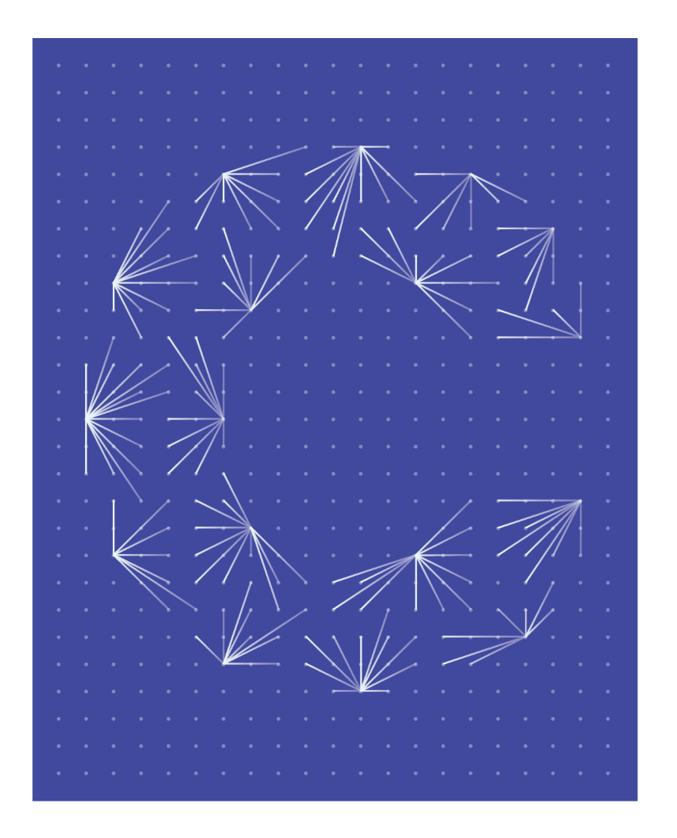

Chief Economists Group Meeting
19 April 2024 – Brussels

Slide 2
agenda
Opening and welcome
Update on the situation in the MET Industries
European Commission Spring Package
Integration of UK data in the Ceemet figures
Discussion on Ceemet figures
International comparison with other regions
Any other business

Slide 3
2. Update on the situation in the MET Industries
  National up-dates
United Kingdom: MAKE UK
Netherlands: FME
Italy: FEDERMECCANICA
Germany: GESAMTMETALL
Finland: TIF
Denmark: DI
Belgium: AGORIA
  Summary by the chair

Slide 4

Manufacturing Economic Outlook
2024/Q1
Economics Unit
Make UK

Slide 5
Overview
Output falls after q4 expansion, Orders remain consistent although subdued
UK orders show very slight improvement, Export order lead diminishes
Rate of Price rising behaviour accelerates, and margins fall further into negative territory
Both labour and investment show growth
Confidence remains robust despite modest metric performance
UK GDP forecast – 2024: 0.6%, 2025: 1.6%
Manufacturing GVA forecast – 2024: 0.1%, 2025: 0.8%

Slide 6
Output stumbles at the start of the year, Orders consistent
% Balance between increase/decrease in output/orders over the past three months

Slide 7
Q1 Performance weak but expectations bullish
% Balance between increase/decrease in orders over the past three months

Slide 8
Performance half as strong as expectations
% Balance between increase/decrease in orders over the next three months

Slide 9
Price increases accelerate, and margins worsen
% Balance between increase/decrease over the past three months

Slide 10
Confidence remains robust
Confidence in the next 12 months: 1 = worse, 10 = better

Slide 11

Employment & Investment both trend upward slightly
% Balance between increase/decrease in employment over the past three months and investment intentions

Slide 12
Forecasts remain weak for 2024
% annual change in output

Slide 13
Review
Output falls after q4 expansion, Orders remain consistent although subdued
UK orders show very slight improvement, Export order lead diminishes
Rate of Price rising behaviour accelerates, and margins fall deeper into negative territory
Both labour and investment show growth
Confidence remains robust despite modest metric performance
UK GDP forecast – 2024: 0.6%, 2025: 1.6%
Manufacturing GVA forecast – 2024: 0.1%, 2025: 0.8%

Slide 14
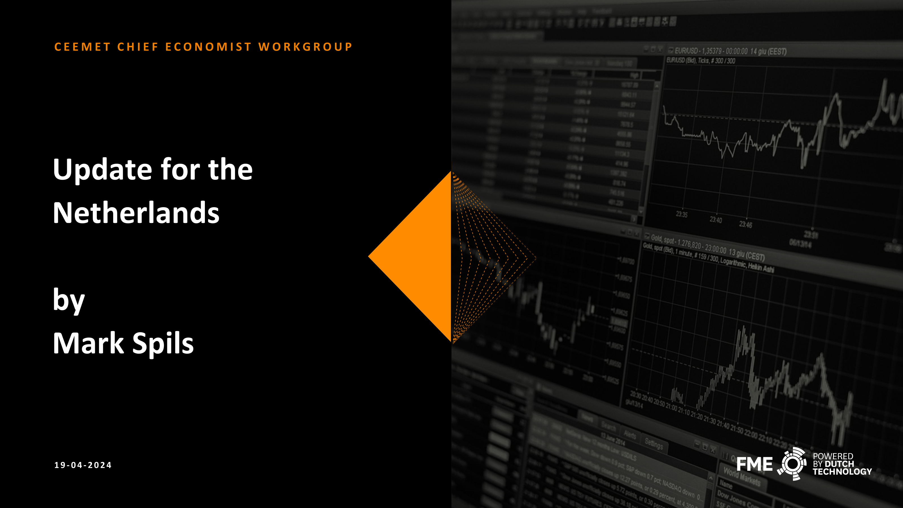
Review
Output falls after q4 expansion, Orders remain consistent although subdued
UK orders show very slight improvement, Export order lead diminishes
Rate of Price rising behaviour accelerates, and margins fall deeper into negative territory
Both labour and investment show growth
Confidence remains robust despite modest metric performance
UK GDP forecast – 2024: 0.6%, 2025: 1.6%
Manufacturing GVA forecast – 2024: 0.1%, 2025: 0.8%

Slide 15
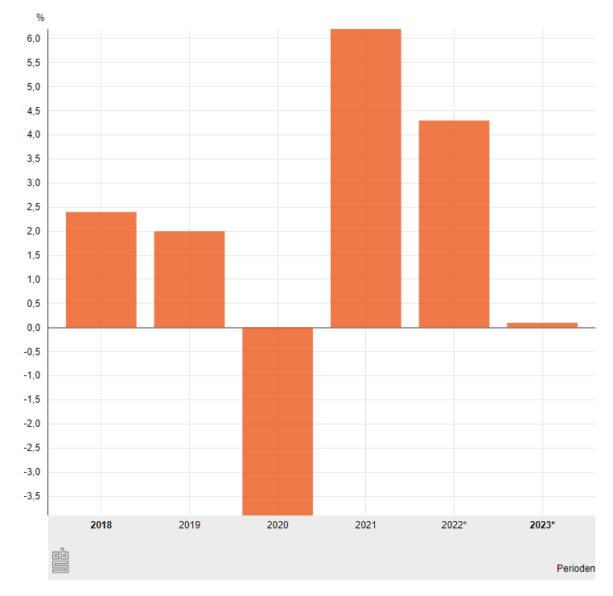
CEW spring meeting 2024 – Update for the netherlands
Looking back at 2023 - economy
State of the Dutch economy
GDP:
“Growth” of 0.1% in 2023 → Due to stronger Q4
End of official recession
GDP Breakdown:
Consumption: +0.4% (Goods <0%, Services >0%)
Investments: +1.4% (Transport +22%, ICT -10%)
Government: +3.0%
Exports: -1.3% (Domestically produced exports: -2.8%)
Imports: -0.8%
Points of concern:
Competition from US/CN leads to terminated production in NACE 24/29.
Low confidence in economy due to political uncertainty.
Low confidence in Dutch industry due to negative image.
Leads to firms hesitating in expansion/investment decisions.
Image campaign started by FME to counter this.
Figure: GDP growth Y-o-Y Source: CBS Statline
* preliminary
Notes:
Verhaal:
Terugkijken 2023
- ook leveranciers gaan goed
- nog effect van internationale ketens
- prinsjesdag presentatie
Verdeling van FME leden over SBI’s laten zien
- 28 heeft een dip gehad in 2023, maar in 2024 verwacht men herstel
% deel export FME-leden laten zien op basis van CBS gegevens
Vooruitzicht 2024
- Hoge rentes met als gevolg lage investeringen
- Minder groei door minder investeringen (Orgalim uitvraag met cijfers van 2024 laten zien)
- Na prinsjesdag 2023 ontwikkelingen als hogere energiebelasting, onzekerheid over subsidies die van invloed zijn op innovatie (nationaal groeifonds)

Slide 16
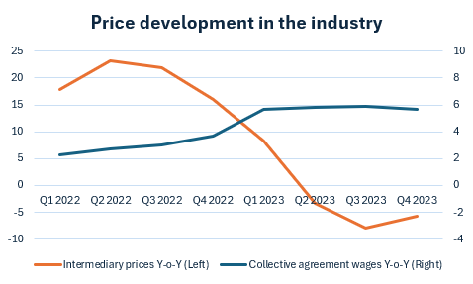
CEW spring meeting 2024 – Update for the netherlands
Biggest issues in 2024
Q2 2021-Q3 2022:
Material shortage
Q1 2024:
No big issue: 36%
Labor shortage: 27%
Lack of demand: 25%
Material shortage: 12%
Q4 2022-Q3 2023:
Labor shortage
Q2 2020-Q1 2021:
Lack of demand
No single biggest issue for entrepreneurs in industry anymore (Source: Conjunctuurenquête CBS)
      Biggest issue per sector:
    NACE 25, 28, 30, 33: Labor shortage
    NACE 26, 27: Material shortage
    NACE 29: Lack of demand
Other issues that companies perceive as problematic include:
high energy prices, congestion in electricity networks, tax climate, facilitating legislation, and the sentiment towards business.
Figure: Price mutations Y-o-Y Source: CBS Statline
Notes:
Verhaal:
Terugkijken 2023
- ook leveranciers gaan goed
- nog effect van internationale ketens
- prinsjesdag presentatie
Verdeling van FME leden over SBI’s laten zien
- 28 heeft een dip gehad in 2023, maar in 2024 verwacht men herstel
% deel export FME-leden laten zien op basis van CBS gegevens
Vooruitzicht 2024
- Hoge rentes met als gevolg lage investeringen
- Minder groei door minder investeringen (Orgalim uitvraag met cijfers van 2024 laten zien)
- Na prinsjesdag 2023 ontwikkelingen als hogere energiebelasting, onzekerheid over subsidies die van invloed zijn op innovatie (nationaal groeifonds)

Slide 17
Expected Future developments
Looking Forward - industry
Low investments due to (political) uncertainity and high interest rates.
Slightly improved GDP (0.3%) and production (+0.5%) in the industry.
But again big differences between sectors: 2024 is a bad year for Mechanical engineering and Transport.
Lack of demand:
70% of industrial sales are exports.
Economic growth of all major trade partners is slower than last year.
Affects NACE 28 Mechanical engineering particularly in 2024, but growth is expected from 2025 onward.
Labor shortage:
Due to some terminated production (in Metal and Transport), unemployment will slightly increase from 3.5% to 3.7%.
This will release some of the pressure on the tight labor market, but wage increases will lead to higher operating costs.
Due to the aging population and fewer tech graduates, industry employment is estimated to shrink from 2026 onwards!
Energy prices will fall by approximately 10-15%
but unfavorable subsidy cuts will lead to higher energy prices for big industry than in neighbouring countries.

Slide 18
CEW spring meeting 2024 – Update for the netherlands
Looking back in the future
          Point of remark: Big differences between index mutations in production with the change to the new base year 2021
New vs Old base year
          Growth rate 2023 (base year 2015):
          ΔIndustry = -7.5%
          ΔMetal-Tech = -8.6%
          ΔMechanical Engineering = -17.1%
          Growth rate 2023 (base year 2021):
          ΔIndustry = -0.4%
          ΔMetal-Tech (NACE 24-30+33) = +5.1%
          ΔMechanical Engineering (NACE 28) = +5.4%
What happens in NACE 28 Mechanical Engineering?
Changed composition in the 6 years between 2015 and 2021 due to rise of Brainport Eindhoven.
Therefore, the weights shifted immensely with the recalibration of the sector in 2021.
Y-o-Y growth rates changed drastically with new weights
Absolute GDP mutations lie closer to new base year
Notes:
Verhaal:
Terugkijken 2023
- ook leveranciers gaan goed
- nog effect van internationale ketens
- prinsjesdag presentatie
Verdeling van FME leden over SBI’s laten zien
- 28 heeft een dip gehad in 2023, maar in 2024 verwacht men herstel
% deel export FME-leden laten zien op basis van CBS gegevens
Vooruitzicht 2024
- Hoge rentes met als gevolg lage investeringen
- Minder groei door minder investeringen (Orgalim uitvraag met cijfers van 2024 laten zien)
- Na prinsjesdag 2023 ontwikkelingen als hogere energiebelasting, onzekerheid over subsidies die van invloed zijn op innovatie (nationaal groeifonds)

Slide 20

ITALY
CEEMET National Update
April 2024

Slide 21
GDP dynamics ITALY
(yearly percentage)
2024 forecast
0.6%-1.0%
SOURCE: ISTAT, GDP and General Government Net Borrowing, March 2024.

Slide 22
Production Dynamics - 2023
(tendential and cyclical variations in each quarter)
tendential variations
cyclical variations
SOURCE: Elaborations on ISTAT data

Slide 23
Metalworking Production by Industrial Sector
( 2023/2022 percentage change)
SOURCE: Elaborations on ISTAT data

Slide 24
Italian Metalworking Exports by Destination Market
(2023/2022 percentage change)
 | Billions € | SHARE % | Percentage change
WORLDWIDE | 287.3 | 100.0 | 2.7
EU27 post Brexit | 150.2 | 52.3 | -0.1
EXTRA EU27 post Brexit | 137.1 | 47.7 | 5.9
GERMANY | 39.5 | 13.7 | -2.1
UNITED STATES | 33.0 | 11.5 | 8.8
FRANCE | 27.6 | 9.6 | 1.0
SPAIN | 16.0 | 5.6 | 4.0
UNITED KINGDOM | 12.5 | 4.3 | 3.4
SWITZERLAND | 10.2 | 3.6 | -1.2
TURKEY | 7.9 | 2.7 | 10.9
CHINA | 6.6 | 2.3 | -7.0
INDIA | 3.2 | 1.1 | 11.9
JAPAN | 2.5 | 0.9 | 7.1
RUSSIA | 1.8 | 0.6 | -37.0
SOURCE: Elaborations on ISTAT data

Slide 25
Portfolio Orders
(quarterly balances)
SOURCE: FEDERMECCANICA – Quarterly survey

Slide 26
Production and Employment Forecasts
(quarterly balances)
SOURCE: FEDERMECCANICA – Quarterly survey.

Slide 27
Thank You For Your Attention
Ezio Civitareale and Elena Falcone

Slide 28

MET
Business cycle report
Notes:
ok

Slide 29
Recession in the MET Industry Accelerated at the Beginning of the Year - No Turnaround in Sight
MET Production fell by 2.1% in January 2024 compared to December. The three-month average was down 1.2%. This means that production is once again 15% points below the pre-crisis level of 2018.Production, sales and turnover also turned down after the catch-up effects at the beginning of the year. In November sales fell for the sixth month in a row. In addition to weak domestic business, both euro-zone and non-European sales are declining.
Turnover and sales were also down at the start of the year. The downward trend thus continues. Sales have fallen by 7% since May 2023. In addition to the weak domestic business, sales outside the eurozone in particular are falling noticeably.
New orders are still on a downward trend. The order volume in January was around 7% below the previous year. The book-to-bill ratio is still below 100%. The order backlog is therefore shrinking, which means that production and sales may also continue to fall for the time being.
In January 2024, the number of employees in MET based industries was still 0.8% higher than in the previous year. Seasonally adjusted, the sideways movement has continued since April 2023. As a result of the downturn, the skills gap is gradually narrowing. Nevertheless, one in three companies in the MET industry could produce more if the right staff were available.
The MET business climate stabilised somewhat in March. The proportion of pessimists decreased slightly. Other sentiment indicators are also slowly showing signs of an economic bottoming out.
Another decline is forecast for industrial production in 2024, which means that Germany's economic development, which is far below average by international standards, is likely to continue. Production in the MET industry is likely to fall by 2 to 3%.
The inflation rate fell further to +2.5% in February. However, political measures and strong wage momentum slowed disinflation and kept core inflation unchanged at a high level.

Slide 30








Annual Overview 2024: MET Industry in Recession at the Start of the year
Real** | Nominal
-7.3% | -5.9%
-6.9%
-3.5% | -1.8%
-2.3% | -0.2%
Nominal
+0.8%
+0.4%
+3.1%
+8.8%
New Orders*
Employment
(∆ Jan)
(∆ Jan)
Production*
Hours worked
(∆ Jan)
(∆ Jan)
Turnover*
Wages & salaries
(∆ Jan)
(∆ Jan)
Foreign Turnover*
Unit Labour Costs
(∆ Jan)
(∆ Jan)
Changes in Economic Indicators for the German Metal and Electrical Industry from January 2024 compared to the Same Period in the Previous Year, Employment: Latest available monthly data. Preliminary values before the annual correction & the annual survey for companies with 20-50 employees, Source: Federal Statistical Office; Gesamtmetall calculations *Calendar and seasonally adjusted values **Price-adjusted values

Slide 31
MET Production: Recovery Reversed – Plans Indicate Accelerated Decline
New Orders MET Industries
Index Ø 2021 = 100. Price-, season- and calendar-adjusted monthly values & 3-Month moving average.
The order volume in January was 8.7% lower than in December. It should be noted that major orders were booked at the end of the year, primarily from the eurozone and Germany. As expected, the development of new orders is therefore back on the downward trend of recent months. Compared to the previous year, new orders in January were down 5.9% (nominal) or 7.3% (price-adjusted). A clear majority of MET companies were also dissatisfied with their order backlog in March. Demand deteriorated again slightly compared to the previous month.
∆ Nov/Okt
-1.3%
Dez → Jan
Jan 2024/Dez 2023
-8.7%
Source: Federal Office of Statistics

Slide 32
MET Production: Recession Accelerates - Gap to Pre-Crisis Level Widens Further
Production MET Industries
Index Ø 2021 = 100. Price-, season- and calendar-adjusted quarterly values
The decline in MET industries production has accelerated further. In January, the production volume was 2.1% below December, after output in Q4 had already fallen by 1.7% compared to the previous quarter. The previous year's figure was undercut by almost 7%. The gap to the pre-crisis level in Q2 2018 now totals 15 points again. The catch-up effects resulting from the improved materials situation have therefore largely run their course. The production plans of MET companies stabilised somewhat - partly because the materials situation improved again. However, they remained predominantly on a downward trend in March.
15 Pkt.
Q4 → Jan
Jan 2024/Dez 2023
-2.1%
Source: Federal Office of Statistics

Slide 33
Revenue & Sales: Decline Further Intensifies at the Beginning of the Year
Sales delvelopment in the MET Industry
Index Ø 2021 = 100. Season-, calendar- and price-adjusted values per quarter
Turnover in the MET industry fell by 2.4% in January compared to December, which was characterised by year-end settlements. Price-adjusted sales fell by 2.8% compared to the previous month.
This further accelerated the decline. In Q4, sales had fallen by 1.8% compared to the previous quarter. Both turnover (-1.8%) and sales (-3.5%) are now below the previous year's level. Compared to the peak in May 2023, the decline in sales totalled 7%. Sales are falling particularly in Germany & outside the eurozone.
Sales & turnover follow the drop in new orders & declining production. Order backlogs are assessed as increasingly weak and stabilise the situation far less than hoped. The downward trend is therefore likely to continue in H1.
Eurozone
Q4 → Jan
Non-eurozone
Domestic
∆ Sales Q4/Q3 2023
Ø MET Industry | -1,8%
Domestic | -3,4%
Foreign | -0,7%
thereof Eurozone | -1,4%
thereof Non-eurozone | -1,8%
Source: Federal Office of Statistics

Slide 34
Key Economic Indicators in the MET Industry: Recession Intensifies at the Start of the Year
Development of incoming orders, sales & production in the MET Industry
Price, calendar, and seasonally adjusted values.
Order volume
Indices*
Book-to-Bill**
Sales
Q4 → Jan
Production
Q3 → Okt+Nov
Source: Federal Office of Statistics; Gesamtmetall calculations *Reindexed to Ø 2015 = 100 ** Incoming orders in relation to sales
MET business cycle report, March 2024

Slide 35
Sector Portfolio: Persistent Differences Due to Mix of Crises and Structural Change
New Orders & Production Index* for MET industries
Price, seasonally and calendar adjusted values for Q4-2023
other Vehicle Production
Metal Products
Electronics
Manufacture of
machinery and equipment
Castings
Electrical Equipment
New orders index (Ø 2015 = 100)
Source: Federal Office of Statistics, Gesamtmetall calculations *Values without WZ 32+33, Reindexed at Ø 2015 = 100)

Slide 36
Employment Development Stable - Skill Shortages Remain Problematic Despite Economic Downturn
Change in MET Employment
Seasonal adjusted Index (left) and Δ Previous month (right)
In January, there were ~ 3.96 million employees in the MET indudustry. Seasonally adjusted, the number of employees remained at the previous month's level and thus continued the sideways movement observed since the spring. Compared to the previous year, the number of employees rose by +32,700 or +0.8%. Reconstruction is being slowed by the weak economy. Personnel plans were also predominantly negative in March. On the other hand, the labour shortage continues to be a major problem and is the second most important obstacle to production after the lack of orders. The statistical skills gap is gradually narrowing: 239,000 STEM jobs could have been filled in February if the right staff had been available. Despite the decline (-22% compared to the previous year), the gap is still large.
M+E employee index
(Ø 2021 = 100)
∆ Previous month
Source: Federal Office of Statistics; Gesamtmetall calculations; projections based on monthly reports for companies ≥ 50 employees

Slide 37
Utilization Falls Below Long-Term Average - Order Backlog Increasingly Viewed Negatively
Order backlog & capacity utilisation in the MET industry
Seasonal adjusted Index (left) and Δ Previous month (right)
As a result of declining new orders and order postponements, MET companies are taking an increasingly negative view of the order backlog. Capacity utilisation fell to 83% at the beginning of the year, 2% points below the long-term average. Companies in the metal sector in particular are reporting weak capacity utilisation. However, the situation has also deteriorated noticeably in the electrical industry.
The order backlog fell by half a month to 4.6 months. However, it is very uncertain whether the orders accumulated during the special economic situation in 2021-2022 can actually be realised. This threatens to further exacerbate the downturn.
Order backlog
Capacity utilisation
Ø* -6 Pt.
Ø* 85%
Source: ifo Business Survey *Long-term average since 2002

Slide 38
Inflation Rate Decreases - (Geo-)Political & Structural Factors Slow Down Disinflation Process
Development & outlook inflation rate
∆ Consumer prices* (right) & balance of ifo-survey price expectations (left)
Inflation fell to +2.5% in February. It (delayed) follows the slowdown in price plans and the decline in wholesale and producer prices. Compared to the previous year, inflation rates weakened further as a result of the weaker economy & monetary policy tightening. However, political measures, rising network charges & structural (wage) cost pressure, particularly due to demographics & decarbonization, slowed the disinflation process noticeably at the start of the year, which was reflected in unchanged high core inflation & a broadening of price increases compared to the previous month. However, in view of the recession, companies' price plans are easing again despite the cost pressure, meaning that inflation is likely to weaken further over the course of the year.
Cosumer prices (YoY)*
Feb.
Price expectations (T+6 Month)
Mar. (Sep.)
Source: *calendar and seasonally adjusted values from the Deutsche Bundesbank; price expectations: ifo Business Survey, moving 3-month-average, value shifted forward by 6 months

Slide 39
Production Development World vs. Germany: Noticeable Decoupling from Global Growth Since 2019
MET production compared to the global evolution of industrial production
Price, calendar, and seasonally adjusted values (Ø 2015 = 100)
Global Industry
EU Industry
US Industry
Jan./Feb.
MET Industries (GER)
Source: CPB WORLD TRADE MONITOR; FRED, Industrial Production: Manufacturing (NAICS); Eurostat; Federal Office of Statistics; Gesamtmetall calculations

Slide 40
European Industrial Production Above German Trend Since COVID-19 - Currently Also in Decline
MET production compared to the global evolution of industrial production
Price, calendar, and seasonally adjusted values (Ø 2015 = 100)
EU Industries
MET Industries EU27
MET Industries Germany
Jan.
Source: Eurostat; Federal Statistical Office; Gesamtmetall calculations

Slide 41
Sentiment Stabilizes in March - Hopes for Bottoming Out Increase
Ifo business climate MET-Industries, Seasonally adjusted balances of the +/- reports
Situation
The mood among MET companies stabilized somewhat in March. The proportion of pessimists decreased. The assessment of the situation did not deteriorate any further. However, assessments of demand trends and orders on hand remained negative. Production plans also remained on a downward trend. Export opportunities, on the other hand, were viewed more favorably.
Mar.
Expectations
Assesment of order book: -22 Pt.
Production Plans: -7 Pt.
Export expectations: +2 Pt.
Personnel Plans: -10 Pt.
Price expectations: +11 Pt.
Demand Compared to the Previous Month: | -8 Pt.
Source: Ifo Business Survey, March 2024

Slide 42
European industrial production weakens
MET production compared to the evolution of European industrial production
Price, calendar, and seasonally adjusted values (Ø 2015 = 100)
Nov
Source: Eurostat; Federal Office of Statistics; Gesamtmetall calculations

Slide 43
Employment Development Stable – Skilled Labor Shortages Continue to be Problematic Despite Weak Demand
Change in MET Employment Compared to the Same Month Last Year
Δ November 2023/November 2022 by MET Economic Sectors.
In November, approximately 3.98 million employees were working in the MET industry, which is an increase of 40,000 or 1.0% compared to the previous year. The number of employees remained at the same level as the previous month when seasonally adjusted, continuing the sideways movement since spring. Weak demand is slowing down the rebuilding process, while labor shortages remain a major problem. Personnel plans were again negative on balance at the beginning of the year. 31% of all MET companies could increase production with appropriate personnel, making staff shortage the second most significant production obstacle after order shortage. Material shortage still hinders production in 18% of MET companies. The gap in statistical skilled labor is decreasing slightly. In December, approximately 264,000 STEM positions could have been filled if the right personnel were available.
Other Vehicles
Electronic Industries
Maintenance
Machinery
Metal Products
Other Manufacturing
Castings
Source: Federal Office of Statistics, Gesamtmetall calculations

Slide 44
Decline in Inflation Rates: Factors of a Political and Structural Nature Slow Down the Disinflation Process
Development & Outlook Inflation Rate
Δ Consumer Prices (right) & Balance of Ifo Price Expectations of German Companies (left)
Inflation rates significantly decreased in the autumn, mostly due to base effects in energy prices. Although wholesale and producer prices are still dropping, energy and energy-intensive preliminary products continue to be considerably higher than pre-crisis levels.
The disinflation process is gradually expanding. Nevertheless, political measures, along with wage and cost pressures, have the potential to hinder the decline in inflation as we approach the turn of the year. Companies' prices are rising again, partly due to structural factors such as demography, decarbonisation, and decoupling. The Bundesbank projects a sideways movement slightly above the 2% goal in the next few months.
Consumer prices (Year-over-Year)
Nov
Business Price Expectations (T+6 Months)
Source: Federal Office of Statistics, ifo Business Survey (Price Expectations Shifted Forward by 6 Months)

Slide 45
Excursus: Reliability of Economic Beacons for 2024

Slide 46




How Reliable are the Economic Beacons of Hope for 2024?
The prospects for a revival of consumption, investments, and global trade remain highly uncertain
Inflation ↓
(Real-)wages ↑
Interest ↓
Private consumtption
Investments
Structurual changes
(Geo-)political framework
Global trade

Slide 47
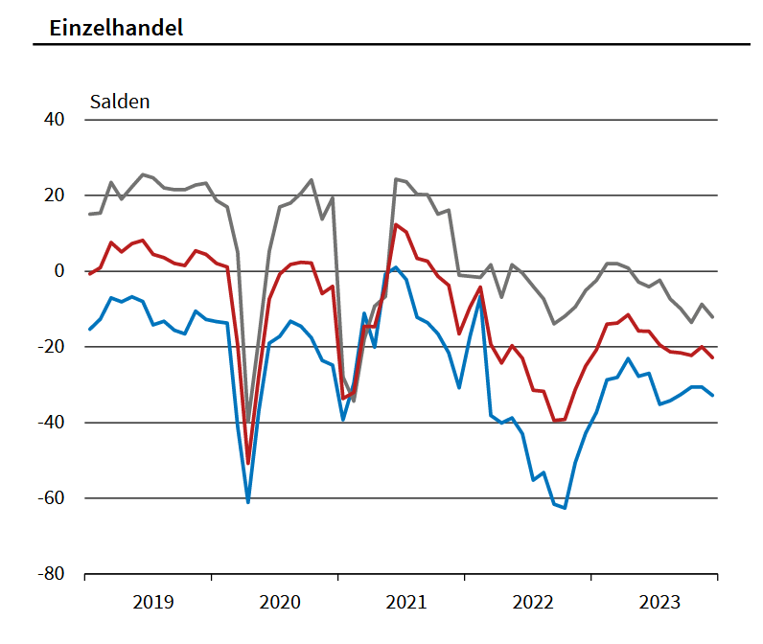
Private consumption remains weak - outlook remains cautious given looming burdens
Business climate
Business situation
Business expectations
Stable labour market with secure employment prospects
There has been a (slight) increase in real wages since the second quarter of 2023, which is expected to intensify as a result of high wage settlements and falling inflation.
Savings activity
Consumer confidence remains in negative territory, indicating that consumers remain highly uncertain about inflation and the political environment with (foreseeable) additional burdens.
Retail sales continue to fall significantly in real terms:
    November: -2.5% mom and yoy.
    Estimated Δ 2023/2022: -3%.
    Negative business climate in trade and services (trade and consumer-related services deteriorated further in December)
    IW: Private consumption is expected [2024] to be 1% above the previous year's level in 2024, returning to its pre-CVD-19 pandemic level.
Retail
balances
Source: Ifo Business Survey; Federal Office of Statistics; IW Köln

Slide 48
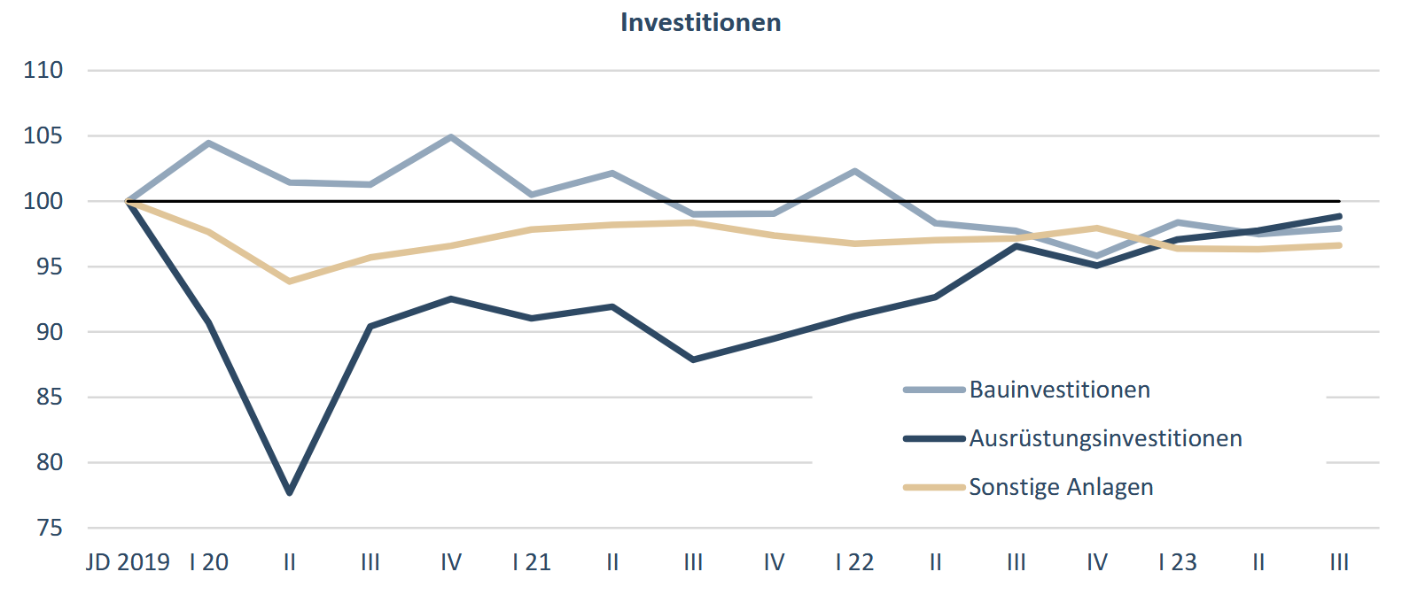
A reliable policy framework is needed to boost investment
Indizes Investitionen (VGR), Ø 2019 = 100
Investment needs, especially in technology & energy transition, and catch-up effects from COVID-19 & supply constraints
Long-term interest rates are trending down in anticipation of a change in interest rates
Subsidy policy
Continued restrictive lending practices
Very negative assessment of location & record FDI outflows
Extremely poor construction sentiment due to falling demand
    Residential building permits: -27% Jan-Oct 2023/2022
    Real new orders: -5% Jan-Oct 2023/2022 (but stabilising in H2 + ongoing price effects)
    Capacity ↓ < 70% / 45% of construction firms with order backlog ↑
    IW: The current weakness in investment is unlikely to be overcome. At least the companies surveyed in the IW business survey are pessimistic overall about their own investment activity. (27% of companies with higher vs. 36% with lower investment budgets)
Investment Indices
Building investments
Equipment investments
Other investments
→ Demand slumps in construction and equipment investment remains weak.
Source: IW Köln

Slide 49
Revival of global trade uncertain - German industrial production well below global trend since 2018
Industrial production indices (2015 = 100)
∆ Industrial production Jan-Nov 2023/Ø 2018
MET GER
Global Industry
Global Trade
EU Industry
US Industry
Global Industry
Global Trade
EU Industry
EU MET Industries
US Industry
GER MET Industries w/o automotive
GER MET Industries
IW: The outlook for the global economy remains clouded by the ongoing geopolitical instability, restrictive monetary policies and volatile energy prices. In particular, the global industrial economy has weakened significantly.
→ In addition, even a revival in global demand would lead to significantly lower economic momentum in Germany than in the past, given the deterioration in the business environment and competitive conditions.
*Ø Jan-Nov Source: CPB WORLD TRADE MONITOR; FRED, Industrial Production: Manufacturing (NAICS); Eurostat; Federal Office of Statistics; IW; Gesamtmetall calculations

Slide 50
Economic Outlook
Technology Industries of Finland
February 2024

Slide 51
Economic Forecasts for Finland
Forecaster | Date | Change in GDP, % |  |  | Change in private Consumption, % |  |  | Change in Exports, % |  |  | Change in Investments, % |  |  | Inflation, % * |  |  | Unemployment rate, %
 |  | 2023 | 2024 | 2025 | 2023 | 2024 | 2025 | 2023 | 2024 | 2025 | 2023 | 2024 | 2025 | 2023 | 2024 | 2025 | 2023 | 2024 | 2025
Danske Bank | 5.3.2024 | -1 | -0,4 | 1,9 | -0,2 | 1 |  | -0,5 | 1,5 |  | -5 | 1 |  | 6,2 | 2 | 1,6 | 7,2 | 7,9 | 7,4
Nordea | 24.1.2024 | -0,5 | -1 | 2 | -0,8 | 0,4 | 1,9 | -0,4 | -2,4 | 2,2 | -5,3 | -4,7 | 3,5 | 6,2 | 2,1 | 1,1 | 7,3 | 8,2 | 7,8
OP FG | 30.1.2024 | -0,4 | 0 | 1,4 | -0,5 | 0,5 | 1,5 | -0,5 | -0,5 | 2,5 | -5 | -1,5 | 4 | 6,2 | 2 | 1,9 | 7,2 | 7,7 | 7,7
Ministry of Finance | 19.12.2023 | -0,5 | 0,7 | 2 | -0.8 | 0,7 | 2 | -1,3 | 2 | 3,8 | -5,6 | 2,2 | 4,6 | 6,3 | 2 | 1,4 | 7,2 | 7,5 | 7,1
Bank of Finland | 15.3.2024 | -1 | -0,5 | 1,7 | -0,8 | 0,5 | 1,3 | -1,2 | -1,4 | 2,5 | -5,5 | -0,8 | 4,4 | 4,3 | 0,9 | 1,4 | 7,2 | 7,8 | 7,4
ETLA | 14.9.2023 | -0,3 | 0,8 | 1,2 | -0,2 | 0,9 | 1,2 | -0,3 | 7,1 | 3,6 | -4,6 | 1,9 | 2,2 | 6,3 | 1,9 | 1,5 | 7,2 | 6,8 | 6,4
PTT | 20.3.2024 | -1 | -0,6 | 1,2 | 0,4 | -0,7 | 1,4 | -1,7 | -3,6 | 2,6 | -4,2 | -2,5 | 3,6 | 6,2 | 1,9 | 2,6 | 7,2 | 8 | 7,8
Labore | 28.9.2023 | -0,3 | 0,8 | 1,7 | -0,2 | 1 | 2 | 0,3 | 0,8 | 1,9 | -2,1 | 1 | 3,7 | 6,1 | 2,4 | 1,8 | 6,9 | 6,7 | 6,7
European commission | 15.2.2024 | -0,4 | 0,6 | 1,6 | 0,2 | 1,3 |  | 0 | 3,9 |  | -4,1 | 1,6 |  | 4,3 | 1,4 | 1,5 | 7,2 | 7,3 | 7
IMF | 10.10.2023 | -0,1 | 1 | 1,3 |  |  |  | 0 | 3,2 | 3,2 |  |  |  | 4,5 | 1,9 | 2 | 7,3 | 7,4 | 7,3
Average |  | -0,6 | 0,1 | 1,6 | -0,3 | 0,6 | 1,6 | -0,6 | 1,1 | 2,8 | -4,6 | -0,2 | 3,7 | 5,7 | 1,9 | 1,7 | 7,2 | 7,5 | 7,3
*) European commission and IMF report Harmonized Index of Consumer Prices
Updated 4.4.2024

Slide 52
Recovery of consumer confidence appears to have stalled for now
Consumer Confidence in Finland, balance figure
Source: Macrobond, Statistics Finland

Slide 53
Volume of Industrial Production in Finland
*) Excl. Information Technology and Consulting Engineering
Seasonally adjusted volume index
Source: Macrobond, Statistics Finland

Slide 54
Tender requests* received by the technology industry companies in Finland
2008 | 2009 | 2010 | 2011 | 2012 | 2013 | 2014 | 2015 | 2016 | 2017 | 2018 | 2019 | 2020 | 2021 | 2022 | 2023 | 2024
*) ”Have you experienced a notable increase or decrease in the number of requests for tenders in recent weeks in comparison to the situation three months ago”. Balance figure = the share of companies receiving more requests - the share of companies receiving less requests. Negative balance figure indicates that demand has weakened when compared to a situation three months ago.
Source: The Federation of Finnish Technology Industries’ order book survey’s respondent companies
The latest questionnaire in Janurary 2024.

Slide 55
Value of new orders in the technology industry* in Finland
Million euros, at current prices
2010 | 2011 | 2012 | 2013 | 2014 | 2015 | 2016 | 2017 | 2018 | 2019 | 2020 | 2021 | 2022 | 2023
Change: | IV,2023 / IV,2022 | IV,2023 / III,2023
Export: | -23 % | 31 %
Domestic: | -5 % | 40 %
Combined: | -19 % | 33 %
*) Excl. metals industry, game industry and data center companies
Source: The Federation of Finnish Technology Industries’ order book survey’s respondent companies, latest observation October-December 2023.

Slide 56
Headcount number fell slightly in the technology industry in Finland
Number of temporary layed of personnel grew to 16,000 at the end of the year
Source: The Federation of Finnish Technology Industries’ labour force survey

Slide 57
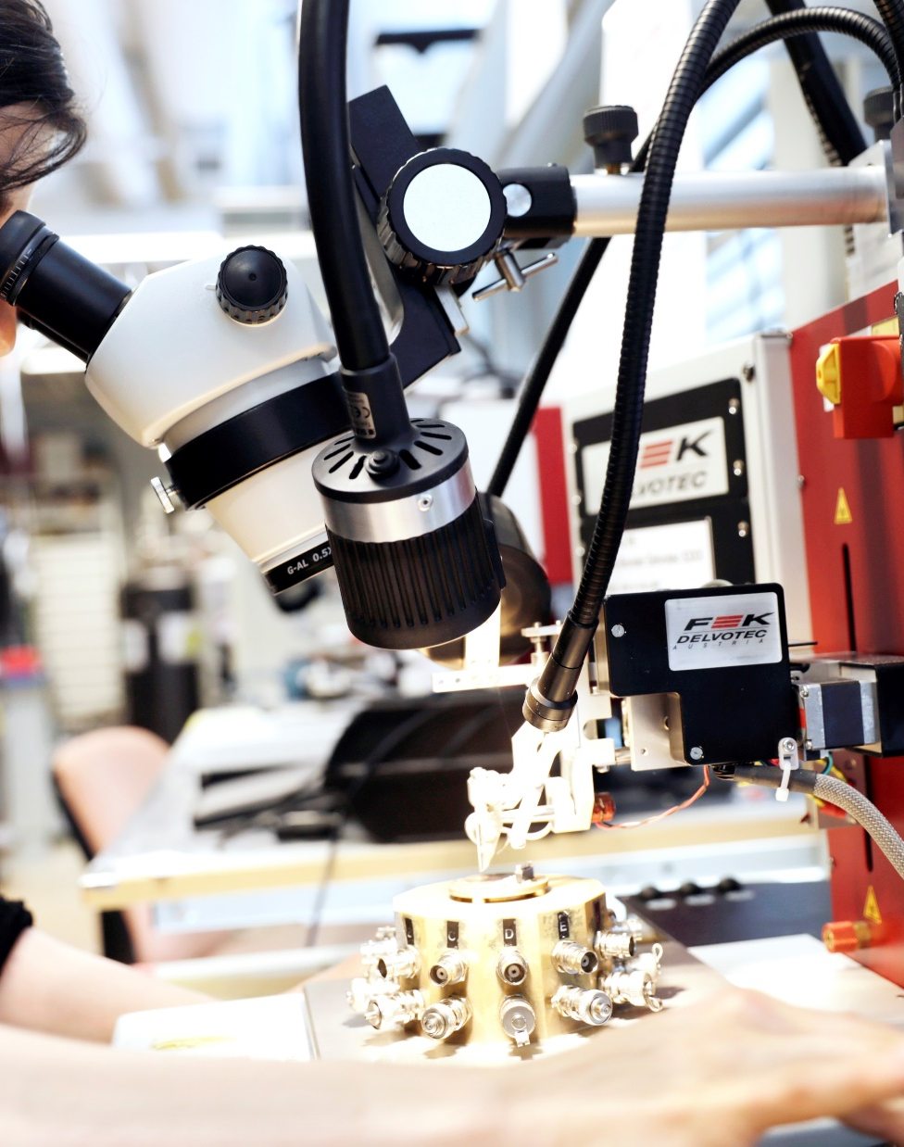
What to expect 2024?
Positive things
  At the end of last year, the factors that caused significant decline in demand slightly eased.
  Expectations for the future have slightly improved. On the other hand, there is nothing concrete yet, only expectations.
  Towards the end of the year, there is possibility to small growth.
Challenges
  Demand remains weak in January.
  The weak level of new orders in the latest quarters will only begin to materialize this year as the value of order books gets thinner -> will affect the employment and production situation.
  The first half of the year will be difficult.
  Wide scale political strikes in the first quarter of his year will cut this year’s GDP about 2 billion € / 0,5 %.

Slide 59
Danish Economy
Allan
Sørensen

Slide 60

Danish activity is at a high level
Danish GDP in 2023: + 1.9%
Without pharma +0.0%

Slide 61

Denmark is a success on pills

Slide 62
Decline in production
Two-thirds of danish production is exported

Slide 63
Neutral expectations for the next 3 months

Slide 64
The capacity pressure is relieved

Slide 65
Employment is expected to decline

Slide 66
Weak demand

Slide 67
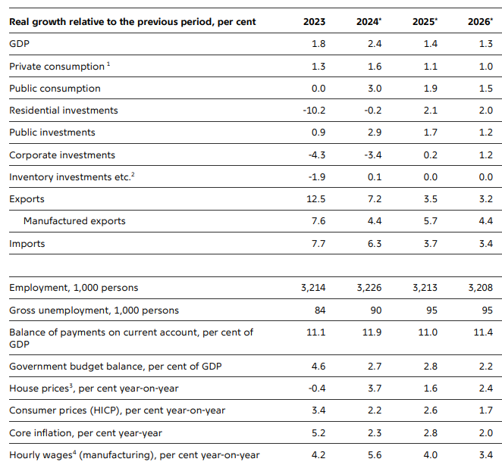
Forecast for Danish economy
Source: Denmarks Nationalbank

Slide 68
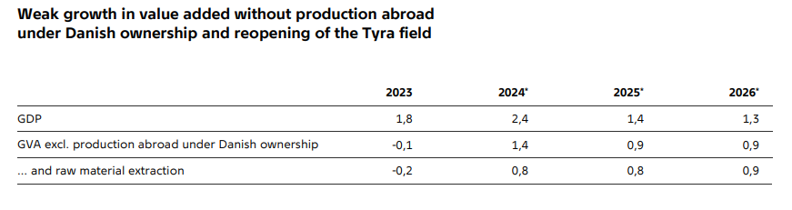
Income from abroad and gas from the North Sea

Slide 69
Forecast for Danish labour market

Slide 71
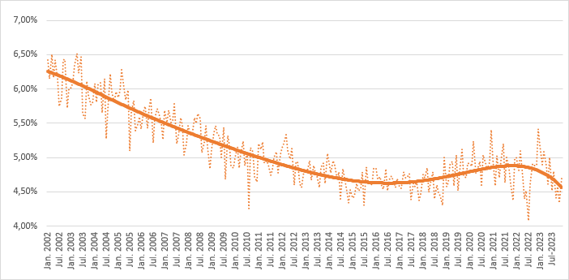
BIGGEST ISSUE:
Market share is decreasing rapidly in 2nd half of 2023

Slide 72
2023 : strong market growth, thanks to investment
Belgian & international markets of the technology industry grew by 3% in 2023. Entreprises investment accelerated to 6% while industrial and construction activity decreased and private consumption was subdued by inflation.
2015 = 100 % year on year
 | 2020 | 2021 | 2022 | 2023
Total market of the Belgian technology industry | -7,6 | 5,7 | 1,8 | 3
Investments of entreprises and public sector | -9,2 | 6,2 | 2,1 | 6
Industrial activity | -4,8 | 5,4 | 1,3 | -2
Activity in construction sector | -5,5 | 4,9 | -0,6 | -1
Private consumption | -7,7 | 5,5 | 3,7 | 1
source : EC autumn forecast (AMECO), Euroconstruct, Oxford Economics, NBB, + calculs Agoria study center

Slide 73
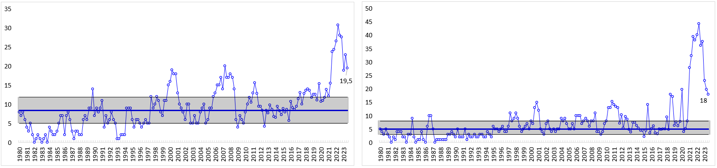
2023 : high obstacles to production throughout the year
Share of entreprises reporting lack of qualified labour force as obstacle to production exceptionally high
Share of entreprises reporting lack of spare parts, components,… is not yet back to « normal »
50% of observations
Median value
source : National bank of Belgium, business surveys

Slide 74
2023 : Increase in turnover thanks to increased prices and activity
Both sales prices and activity grew at a higher rate than during 2015-2020
evol compared with the previous year
Billions euros of sales prices and volume of activity
source : Prodcom + Agoria study center

Slide 75
Quarter on quarter : from growth to stagnation
2015 = 100 % q on q-4
Turnover
Activity
Sales prices
source : Prodcom + Agoria study center

Slide 76


2023 in the sectors
2023 / 2022 % | Turnover | Of which activity | Of which prices
Total | 5,5 | 3,1 | 2,4
Non-ferrous, castings, primary metal transformation | -12,5 | -8 | -4,5
Metal products | 2 | 1 | 1
Electro | 10,5 | 6,5 | 4
Mechanical engineering | 7,5 | 1 | 6,5
Automobile & other transport equipment | 18 | 12 | 6
Telecom | 4,5 | 2,5 | 2
IT Services (wholesale + IT solutions) | 5 | 3 | 2
source : Prodcom + Agoria study center

Slide 77
2023, as for activity : from growth to stagnation
Difference in 4th quarter
Employment compared with the 4th quarter of the previous year
Source : National office for social security

Slide 78
2023 : Source of employment evolution
Emloyment evolution outside bankruptcies and restructuration was at its lowest level since 2015 (excluding Covid year 2020)
Bankruptcies | -2.261 | -1.426 | -1.660 | -1.352 | -1.748 | -1.387 | -875 | -1.427 | -1.510
Restructurations | -758 | -1.661 | -1.147 | -802 | -1.533 | -2.691 | -1.322 | -323 | -913
Source : National office for social security ; Federal public service employment, labour & social dialog

Slide 79
2023 : Decreasing number of vacancies
Vacancies are still higher than between 2013-2020 ; but they are decreasing fast in 2023
Source: Job Vacancy Survey FPS Economie

Slide 80
Investment increased by 39% in 2 years !
From 4,3 billions euro in 2021 to 6,0 bn euros in 2023
Corrected for investment price increase, we estimate a growth of 20-25% in investment volume
Investment in mio euros evol year on year
VAT statistics ; 2023 based on first 3 quarters

Slide 81
2024 : Turnover, prices and activity volume are growing further, but slowly
evol compared with the previous year
Billions euros of sales prices and volume of activity
source : Prodcom + Agoria study center

Slide 82
2024 in the sectors
In our survey, most entreprises are expecting a slow down compared with 2023.
However negative figures are expected for activity evolution in mechatronics and automobile
2024 / 2023 % | Turnover | Of which activity | Of which price
Total | 2,5 | 1 | 1,5
Non-ferrous, castings, primary metal transformation | 2 | 4 | -2
Metal products | 4,5 | 1,5 | 3
Electro | 5 | 2 | 3
Mechanical engineering | 1 | -2 | 3
Automobile & other transport equipment | -10 | -8 | 2
Telecom | 3 | 1,5 | 1,5
IT Services (wholesale + IT solutions) | 8 | 5 | 3
source : Prodcom + Agoria study center

Slide 83
2024 : stagnation of employment
With counter acting factors at work :
Loss of labour cost compatitiveness and slow down of activity is puting employment under pressure
However shortages and vacancies are still historically high and result in « labour hoarding »
About 1/3 entreprises are mentioning needs linked to the develoment of their activity range
Difference in 4th quarter
Employment compared with the 4th quarter of the previous year
Source : National office for social security ; Agoria survey

Slide 84
Investment expected to slightly decrease
Investment in mio euros evol year on year
VAT statistics ; 2023 based on first 3 quarters

Slide 85
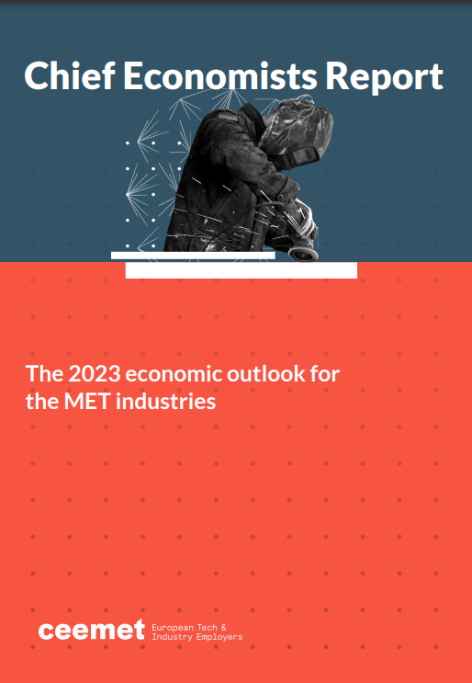
3. European Commission Spring Package
  Update by the Secretariat
  Ceemet Chief Economists Report 2024.

Slide 86
4. Integration of UK data in the Ceemet figures
  Presentation on this topic

Slide 87
4. Integration of UK data in the Ceemet figures
  Presentation on this topic

Slide 88
4. Integration of UK data in the Ceemet figures
  Presentation on this topic

Slide 89
5. Discussion on Ceemet figures
  Presentation of latest figures:
    Labour cost by Alexandre Jagot (UIMM) (Not present)
    Production by Bengt Lindqvist (Teknikföretagen) (Not present)
    R&D expenditures by Fhaheen Khan (Make UK)
    Exports by Patrick Slaets (Agoria)
    Productivity by Lars Kroemer (Gesamtmetall) (Not present)
    Employment by Lars Kroemer (Gesamtmetall) (Not present)
    Hours worked by Elena Falcone (Federmeccanica)
    Investment by Hanne Mikkonen (TIF)

Slide 90
CEEMET CEG Meeting
Labor Cost
April 19th, 2024
Service des études économiques

Slide 91
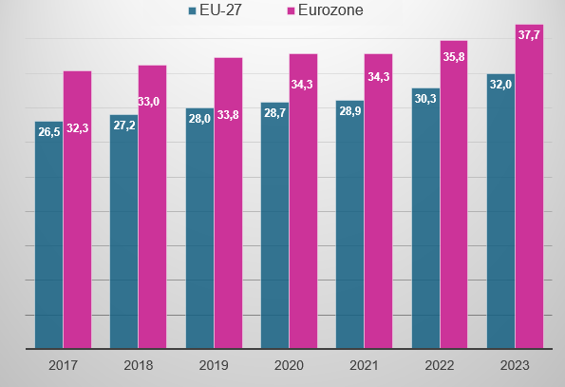
Total HOURLY LABOUR COSTs IN manufacturing industries*
€
*wages + employers’ social contributions + taxes - subsidies (in establishments with 10 or more employees)
Source: Eurostat (labour cost surveys)

Slide 92
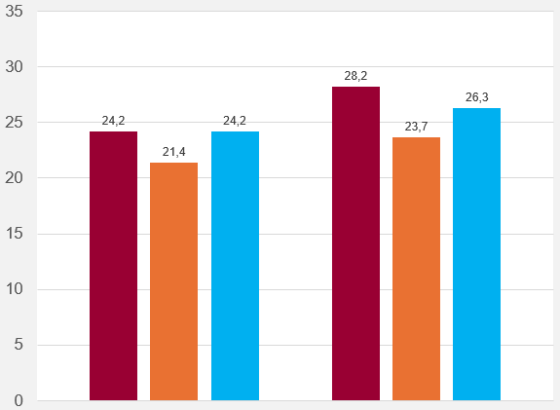
Hourly wages in 2023
€
Manufacturing
Construction
Business services
EU-27
Eurozone
Source: Eurostat (labour cost surveys)

Slide 93
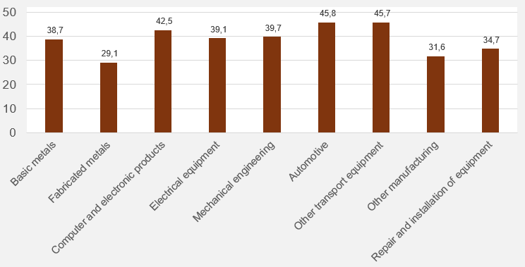
Total HOURLY LABOUR COSTs by sector IN metal industries in the eurozone in 2020*
€
*per employee in full-time equivalents (in establishments with 10 or more employees)
Source: Eurostat (labour cost surveys)

Slide 94
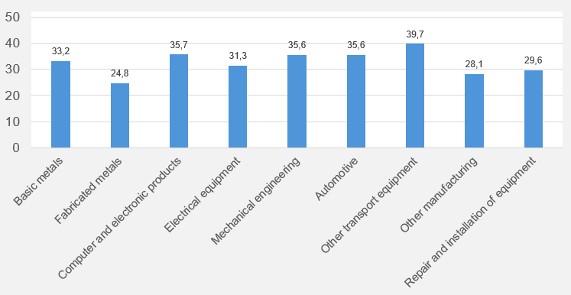
Total HOURLY LABOUR COSTs by sector IN metal industries in UE-27 in 2020*
€
*per employee in full-time equivalents (in establishments with 10 or more employees)
Source: Eurostat (labour cost surveys)

Slide 95
R&D in the MET Industries
Chief Economists Group Meeting
19 April 2024

Slide 96
Overview
Data are incomplete for a number of countries for recent years, making comparisons over time difficult. Figures are reported in USD and have been converted to EUR. Also, due to OECD data migration some historical data has been lost.
Several countries did not report their data for the most recent years. The latest data available on ANBERD (Analytical Business Enterprise R&D) is reported for 2020 for most countries.
Total MET R&D spend at EUR 169bn
Germany and France, UK and Italy accounted for over three quarters (68.6%, slightly down from 70.8%) of total MET R&D expenditure. Motor Vehicles accounted for 36% of MET R&D spend, followed by Electronics at 21% and Mechanical Equipment at 17%.
Biggest spend on subsectors by select countries: Germany (Motor Vehicles), France (Electronics), UK (Motor Vehicles), Italy (Mechanical), Netherlands (Mechanical), Finland (Electronics), Sweden (Motor Vehicles)
Turkey has been included as they are a big player in MET R&D (5th largest by spend)

Slide 97
R&D in MET in the last decade
Source: OECD
Note: Data includes the sum of R&D expenditure by MET industries using OECD ANBERD data. However, due to significant cases of missing data makes this timeseries view somewhat unreliable

Slide 98
€163bn R&D spent in the EU MET industry
Exc: Croatia, Cyprus, Malta, Bulgaria, Latvia, Luxembourg, Netherlands
Other includes countries with less than €1bn in R&D spend
Source: OECD

Slide 99
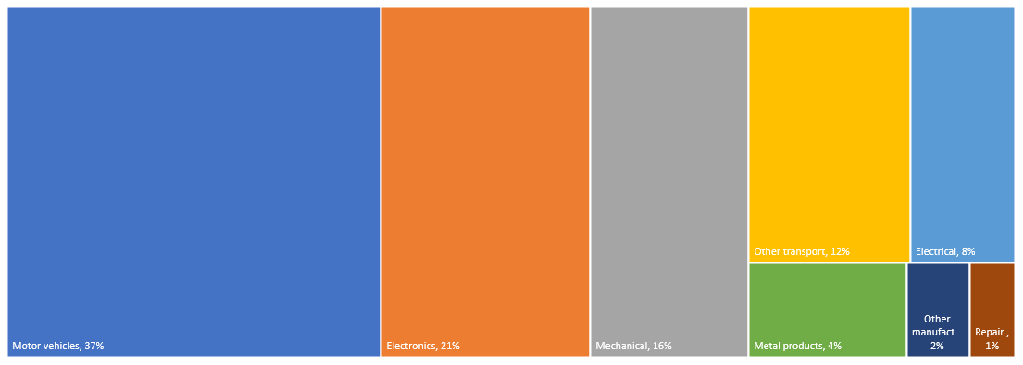
Breakdown by MET subsector (% share)
EUR current prices
Exc: Croatia, Cyprus, Malta, Bulgaria, Latvia, Luxembourg, Netherlands
Source: OECD

Slide 100
Breakdown of MET R&D spend
Select Countries
Source: OECD
Exc: Croatia, Cyprus, Malta, Bulgaria, Latvia, and Luxembourg

Slide 101
Breakdown of MET R&D spend
Select Countries
Source: OECD
Exc: Croatia, Cyprus, Malta, Bulgaria, Latvia, and Luxembourg

Slide 102
Exports in the MET Industries
Chief Economists Group Meeting
19 April 2024

Slide 103
EXPORTS in CEEMET-sectors (2013-2023)
Exports in CEEMET-sectors increased 6% in 2023 (vis-à-vis 2022) in value.
  Historical highest level
  Both Intra-EU & Extra-EU-level increased by 6%
In relative terms, the CEEMET-part in total export increased from 38,7% tot 41,9%.
  It decreased heavily from 2020 to 2020 from 42,6% to 38,7%
  It increased steadily until 2016 to 44,3%. After that, it went down gradually.
  Similar evolutions in Intra-EU and Extra-EU in the last decade.

Slide 104
Productivity
in the European MET Industries (EU 27)
May 15th, 2024

Slide 105
Slow recovery in productivity after c19-crisis
Changes of Productivity year-over-year of MET Industries; Calculation based on annual change rates of production and annual change rates of hours worked; EU27
Source of Data: Eurostat (short term business statistics); calculations by GESAMTMETALL

Slide 106
Summary Conclusions
…In the last decade (2012 – 2020) the development of (labour) productivity in the European MET industry was remarkably lower than in the era before the 2009-crisis
The corona crisis in 2020 has intensified the decline in MET productivity which was caused by a low level - and partly a decline - of MET production and a rising employment on the other hand
2021 and 2022 productivity has recovered due to base effects
high productivity is essential for the competitiveness of EU’s MET industry in the global markets
In order to enhance productivity growth governmental and private investments in the EU have to be raised

Slide 107
Employment
in the European MET Industry (EU 27)
May 15th, 2024

Slide 108
Renewed, but only slight job cuts at MET in 2023
Employees in the MET Industry (Sectors 24 – 30, 32&33*); Age: 15-64; Million; EU27
Source of data: EUROSTAT (lfsq_egan22d)

Slide 109
The Heavy Weights of the MET Industries
Employment of the different Sectors (Sectors 24 – 30, 32&33*); Age: 15-64; in thousand; EU27
Source of data: EUROSTAT (lfsq_egan22d)

Slide 110
Structural Change clearly reflected in medium-term Employment Development
Difference 2023/2019; Employment, Age: 15-64; in thousand; EU27
Σ MET: -275
Source of data: EUROSTAT (lfsq_egan22d)

Slide 111
MET Industries cover half of Industrial Employment
Employment in the MET Industries (Sectors 24 – 30, 32&33*) and in total Manufacturing; Age: 15-64; in thousand; EU27
Source of data: EUROSTAT (lfsq_egan22d + lfsq_egan2)

Slide 112
Summary Conclusions
Employment growth since 2010 was interrupted in 2020 by the Corona Crisis
In 2022, 235,000 fewer people were employed in the MET Industries than in 2019 (- 1.4%)
Nevertheless, the MET Industries has kept the number of employees stable relative to the sharp drop in production during the Corona crisis
Structural change and the Corona crisis are clearly reflected in the medium-term employment trend

Slide 113
HOURS WORKED
in the MET Industries
Chief Economists Group Meeting
19 April 2024

Slide 114
EU27 Average Annual Hours Worked Per Capita Manufacturing
EU27
1.657
1.591
* Belgium and United Kingdom (2022 data)

Slide 115
EU27 Average number of actual weekly hours of work in the main job by gender - Manufacturing 2008-2022
MALES
FEMALES

Slide 116
EU27 Average number of actual weekly hours of work in the main job by gender - Manufacturing

Slide 117
Annual Hours Worked Per Capita Metalworking
Percentage Change 2020/2019 and 2021/2020
EU27
5.2%
-5.9%

Slide 118
NOTES
In most member countries of Ceemet, the 2023 annual average hours worked per capita in the Manufacturing industry increased in comparison to the 2020 pandemic period.
With reference to this increase, in 2023 the hours worked per capita showed a widespread recovery in almost all countries, but with different intensities between them.
Regarding the average number of actual weekly hours of work in the main job by gender, as expected, the curve line for males configurated above that of the females.
But, in the last three years, the trend was different: in 2022 the data for males returned to the 2020 levels and, instead, for females the data remained high.
In MET industry, due to the Covid pandemic, in 2020 a wide decline was observed in the EU27 area, with significant differences between countries. Many of them, in 2021 noted a significant increase, but not allways enough to recover the hours worked per capita lost during the previous year.

Slide 119
Investment in the MET Industries
Chief Economists Group Meeting
19 April 2024

Slide 120
Gross Investment in Tangible Goods of the MET Industries in the EU27+UK
Source: Eurostat, Structural Business Statistics

Slide 121
Investment Rate of Gross Investment in Tangible Goods of the MET Industries in the EU27+UK
Source: Eurostat, Structural Business Statistics

Slide 122
European Commissions forecasts for EU investments
Volume, percentage change on preceding year
 | 2022 | 2023 | 2024 | 2025
Total investment | +2,9 | +1,2 | +1,5 | +2,3
Investment in equipment | +4,2 | +4,0 | +3,0 | +2,9
Source: European Commission, Autumn 2023

Slide 123
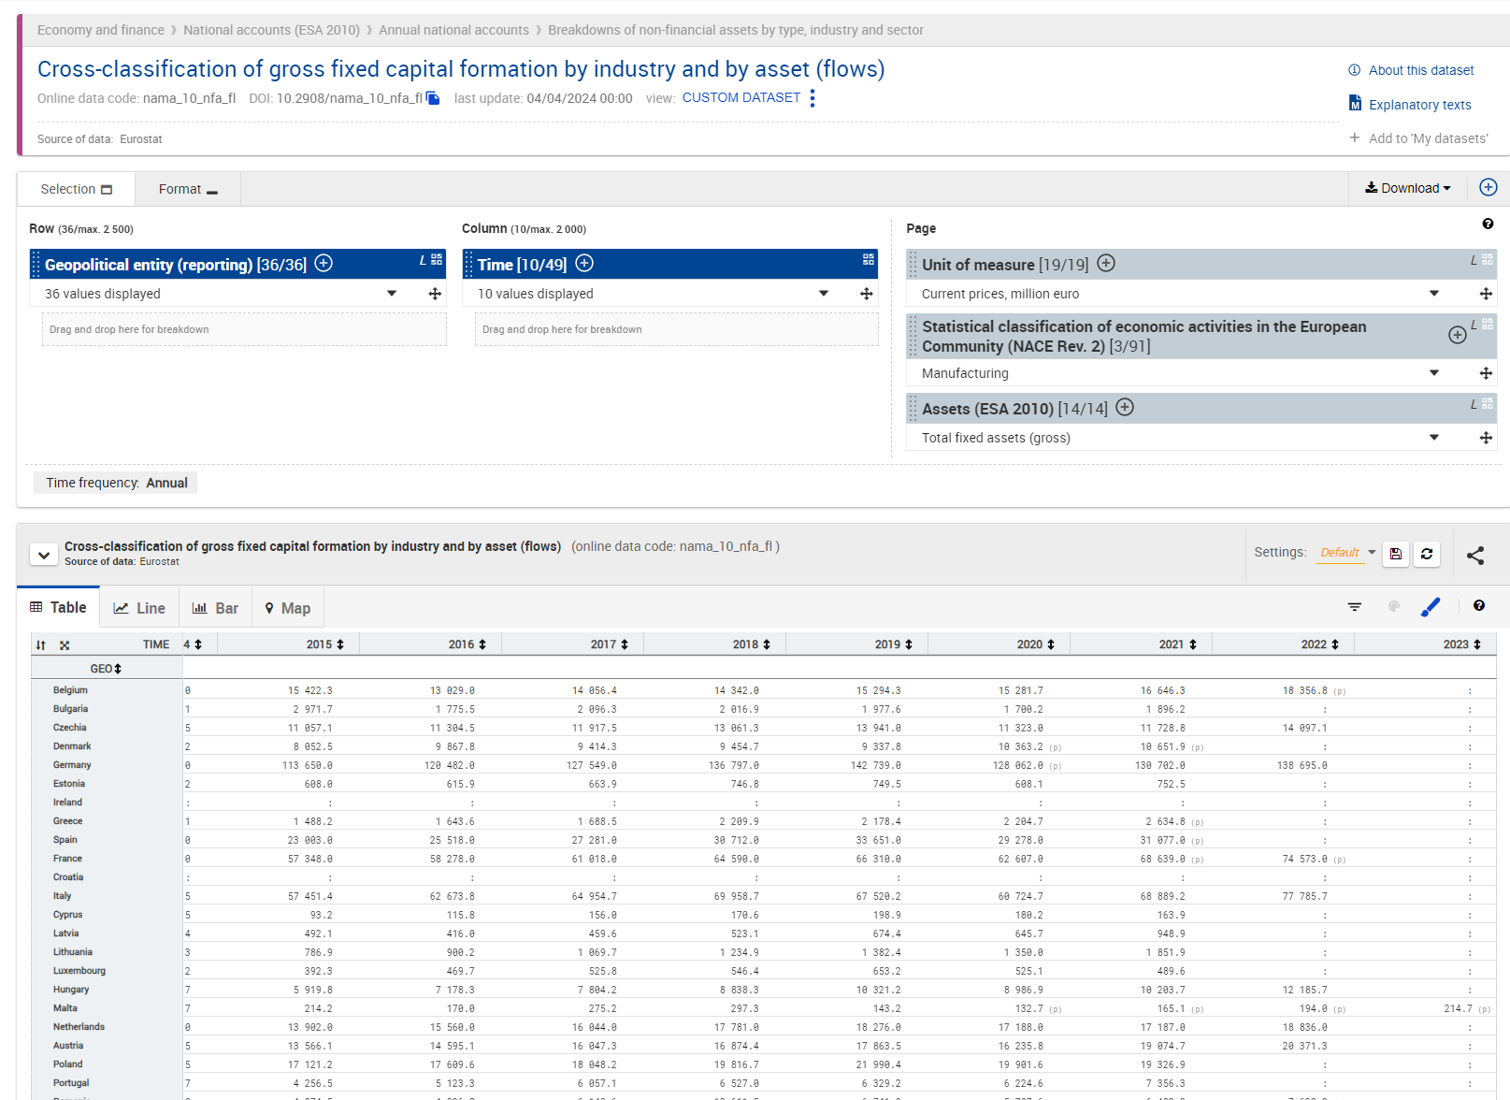

Slide 124
6. International comparison of data with other regions
  Presentation on this topic

Slide 125
International Comparison
MET Industries
Chief Economists Group Meeting
19 April 2024

Slide 126
Labour Cost

Slide 127
Production

Slide 128
Production

Slide 129
Value Added

Slide 130
Value Added

Slide 131
Employment

Slide 132
Employment

Slide 133
Key Figures

Slide 134
Key Figures Per Employed
Working hours in the EU may well be lower than in the US, which will drag productivity up

Slide 135
7. Any other business
  EU value chains
  Date and place of the next meeting

Slide 136

CONTACT
Ceemet
Spaces
Rue Belliard 40
1040 Brussels, Belgium
john.harkin@ceemet.org
www.ceemet.org
@CEEMET
/CEEMET.org

