Slide 1


4th Artificial Intelligence Working Group
28 April 2026, Istanbul

Slide 2
I. AI Governance and Ethics in Workforce Management
Agenda
Presentation by Dr. Mehmet Haklıdır
II. National round table on algorithmic management
III. Update on AI at EU level
a. The 2025/2080(INL) on Digitalisation, AI and algorithmic management in the workplace by MEP Andrzej BUŁA(EPP)
b. Digital Omnibus: consequences on GDPR & AI Act
c. IMET project
d. AI@Work Project
IV. AOB

Slide 3

Introduction

Slide 4
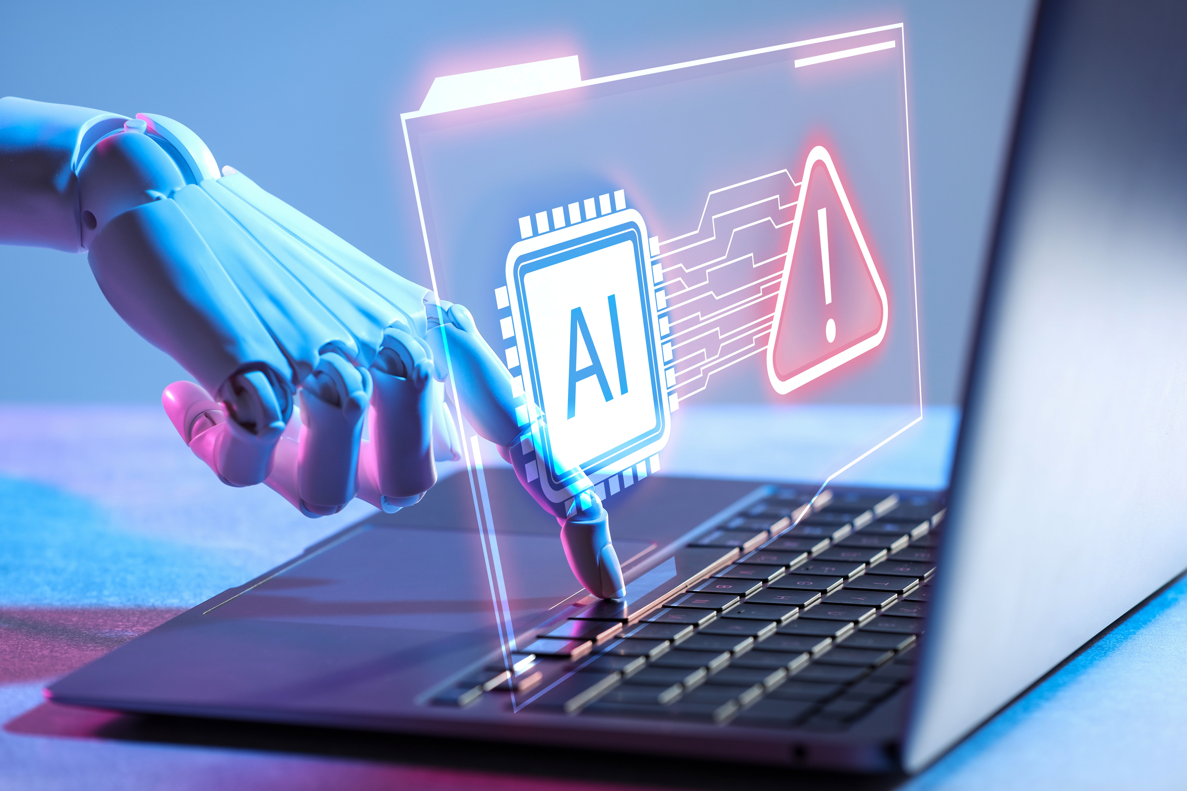
I. Presentation by Dr. Mehmet Haklıdır

Slide 5


I. AI Governance and Ethics in Workforce Management
Presentation by Dr. Mehmet Haklıdır
Director at TÜBİTAK BİLGEM
Artificial Intelligence Institute

Slide 6

II. National Roundtable on algorithmic management

Slide 7

II.National roundtable on algorithmic management
a. ITALY - The example of NOKIA
Nokia Learn XR
The virtual training environment used to deliver certification to Nokia partners. The reference use case is Installation & Commissioning, where Nokia offer six specific courses on IP & Optics equipment.
You can view the 360-degree demonstration video on YouTube : link
You can also download the virtual reality application for your headset from the Meta Store: Nokia Learn XR on Meta Quest | Quest VR games | Meta Store (en-gb)

Slide 8
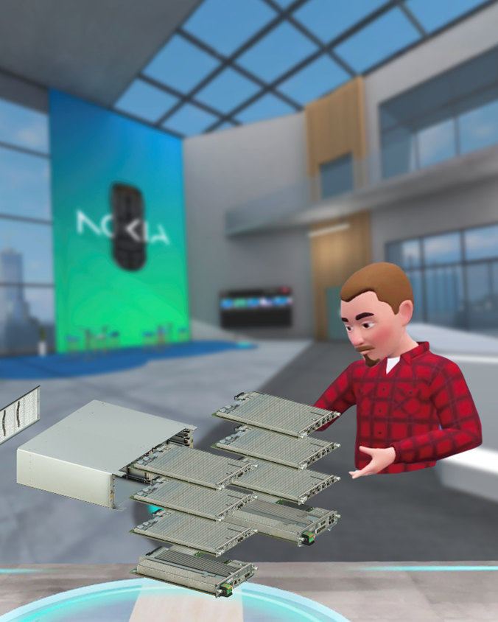
II.National roundtable on algorithmic management
a. ITALY - The example of NOKIA
AI is used to:
Generate dialogue and instructions for the user, for example: "In your next exercise, do...". The instructions change based on the scenarios and actions performed by the user; the logic that determines which suggestions to provide is managed using generative AI models.
Create 3D models and scenarios. We use tools that allow us to generate 3D objects within the environments, significantly reducing scenario production times.
Experiment with automatic translation of content into different languages ​​using AI solutions, with the aim of speeding up material localization.

Slide 9
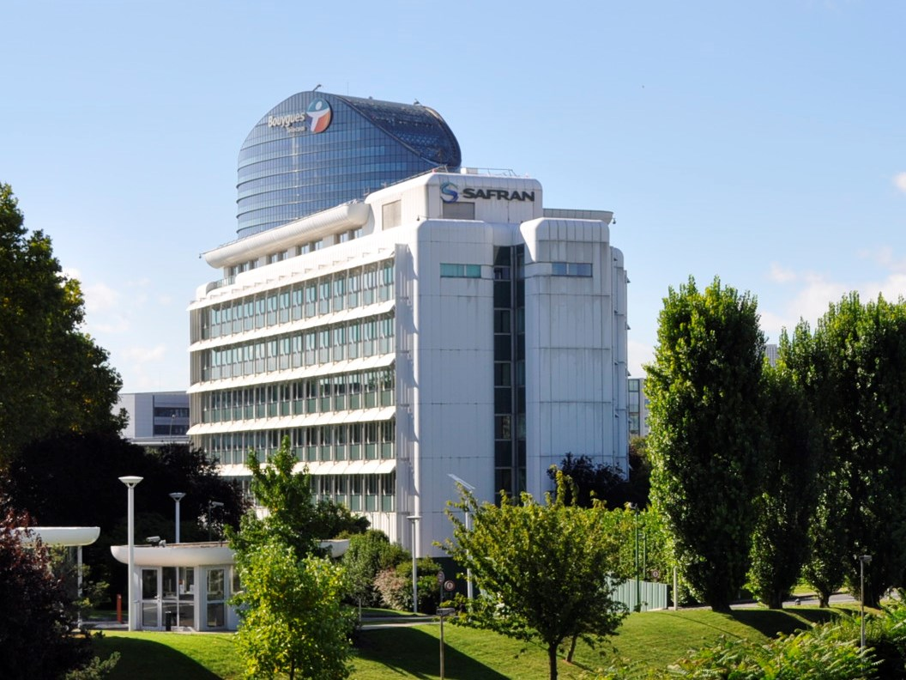
II.National roundtable on algorithmic management
b. FRANCE - The example of Safran and Career Management System (GEPP)
Job and Career Management in Companies (GEPP) applies to companies with more than 300 employees and to EU-wide companies with at least 150 employees in France.
Every three years, employers and social partners must negotiate measures relating to job and career management, with a focus on forward-looking skills strategies (particularly those related to the green transition), internal mobility, vocational training, employment contracts, information on subcontractors and the career paths of trade union representatives. Most of these recent collective agreements contain a chapter or provisions on AI.

Slide 10

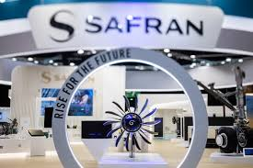

II.National roundtable on algorithmic management
b. FRANCE - The example of Safran and Career Management System (GEPP)
The Safran agreement dd.January 2026 on training and skills. It includes a chapter dedicated to AI on page 30.
In particular, it addresses staff training, monitoring the impact of generative AI on jobs and skills, and the establishment of a supervisory and ethics committee.
The aim of this multidisciplinary committee is to ensure the responsible integration of generative AI, to assess the ethical issues associated with its deployment, and to propose guidelines and best practices tailored to the entire Group.

Slide 11


II.National roundtable on algorithmic management
c. UK - The example of Atlantic
AI is embedded across a wide range of functions, including operations, supply chain, procurement, sales, R&D and strategic planning.
AI systems are currently used to generate recommendations, alerts and scenarios, however they still follow the “human‑in‑the‑loop” approach.
without early digitisation and the recent application of AI, the business would not have been able to scale or maintain its market position.

Slide 12
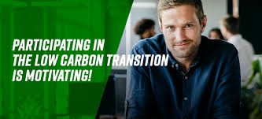
II.National roundtable on algorithmic management
c. UK - The example of Atlantic
No standalone collective agreements or formal consultation mechanisms specific to AI
AI is not being used to manage people or make workforce decisions. It is intended to free employees from routine or low‑value tasks rather than reduce headcount.
Successful adoption depends less on job role and more on mindset, with early adopters and internal champions playing a critical role in bringing others along. The underlying message to the workforce has been framed around shared competitiveness: using AI to “make the boat go faster.”
“The biggest lesson is to find the right people, not the right job titles, to lead AI adoption.”

Slide 13
Technology Industries of Finland
National round table on algorithmic management
Istanbul - 4th Artificial intelligence working group meeting

Slide 14

Wärtsilä Oyj Abp (Plc)
Wärtsilä is a global leader in innovative technologies and lifecycle solutions for the marine and energy industries
It has a dedicated team of 17,900 professionals in 78 countries
In 2025, Wärtsilä’s net sales totalled EUR 6.9 billion
Notes:
Eka pallo: Wärtsilä Marine offers
Engines and generating sets
Propulsion solutions (propellers, thrusters, shafts, nozzles, waterjets) and propulsion control systems
A wide offering of marine gears
Ship electrification and hybrid systems
Energy-saving technologies
Fleet optimisation and voyage optimisation solutions
Exhaust treatment and carbon capture solutions
Wärtsilä Energy solutions include
flexible engine power plants
energy storage and optimization technology
and services covering the entire lifecycle of its installed products.
engines also run on sustainable fuels, ensuring their continued operation well into the future.
Energy storage business: battery energy storage technologies

Slide 15
HR’s approach on AI
Wärtsilä HR set out to improve how HR supports employees and the business by applying artificial intelligence in a purposeful, responsible, and compliant way in a complex global operating environment
The HR AI approach focuses on applying AI where it clearly adds value, while ensuring strong governance, transparency, and human oversight. AI is used to support HR professionals, managers, and employees – not to replace human decision-making
AI initiatives are developed through controlled piloting and close collaboration with Legal, Data Privacy, and IT, ensuring compliance and clear ownership from the outset before scaling solutions more broadly

Slide 16
Multiple AI use cases in HR
Wärtsilä’s HR has implemented and piloted multiple AI use cases that include, for example,:
  Position Description AI Agent that supports recruiters and hiring managers in creating structured job description drafts
  Competence Library AI Assistant that helps structure and maintain global competence data
  Visier VEE that is an AI-powered assistant enabling natural-language access to existing people metrics
  AI-enabled career and development features in SAP SuccessFactors
Notes:
Loppuun: What are the key features of SAP SuccessFactors HCM?
SAP SuccessFactors solutions help organizations manage all functions of HR, including compensation and benefits, employee onboarding, goal management, talent development, time management, and payroll.
Here are some HR processes SAP SuccessFactors HCM can optimize—and how AI can help:
Recruitment: Attract and hire talent with the skills your organization needs. SAP SuccessFactors Recruiting uses AI to screen applicants in a more efficient and equitable way.
Onboarding: Help new hires hit the ground running with a personalized, intuitive, and engaging onboarding process. SAP SuccessFactors Onboarding facilitates the timely completion of necessary tasks, like training or goal assignments. AI can help new and departing employees to easily complete required tasks.
Performance management: Continuously develop and nurture your talent in a way that aligns with their personal goals and those of the organization. AI can help employees craft meaningful, measurable goals.
Learning: Ensure compliance and encourage employee development with skills-driven learning and development. AI can help identify growth opportunities and recommend personalized learning plans.
Employee self-service: Provide employees with a way to quickly complete tasks and get accurate answers to HR-related questions.
Reporting and analytics: Get a comprehensive perspective on employees, including their location, skills, and compensation to better align workforce strategies with business priorities.
Compensation and payroll: Make better decisions about employee pay with real-time budget and market insights from SAP SuccessFactors Compensation. Automate and accelerate payroll processes with SAP SuccessFactors Employee Central Payroll to ensure pay arrives on time and error-free.
Career development: Gain visibility into an organization’s talent gaps and reveal who can fill them with SAP SuccessFactors Career and Talent Development. AI-enabled tools can also help decision-makers assess an employee's potential and analyze how their succession impacts the business.

Slide 17
Results
The Position Description AI Agent reduces time spent per description by approximately 70%, saving an estimated 1,050 hours annually while improving consistency and quality
Visier VEE increases access to people analytics through a deliberately limited, low-risk, and compliant scope
SAP Success Factors AI features improve visibility into career opportunities and strengthen development discussions
In parallel, 29% of the HR organization is equipped with Microsoft 365 Copilot licenses, with exceptionally strong adoption: 94.44% of licensed users are active. Usage spans Teams, Copilot Chat, Word, Outlook, Excel, and PowerPoint, indicating that Ai enabled ways of working are already embedded in everyday HR collaboration
Notes:
Loppuun: To sum up, by combining ambitious piloting with responsible implementation – clear ownership, early legal and data privacy involvement, human-in-the-loop oversight, and controlled scaling – Wärtsilä HR is realizing the benefits of AI in a trustworthy and sustainable way.

Slide 18
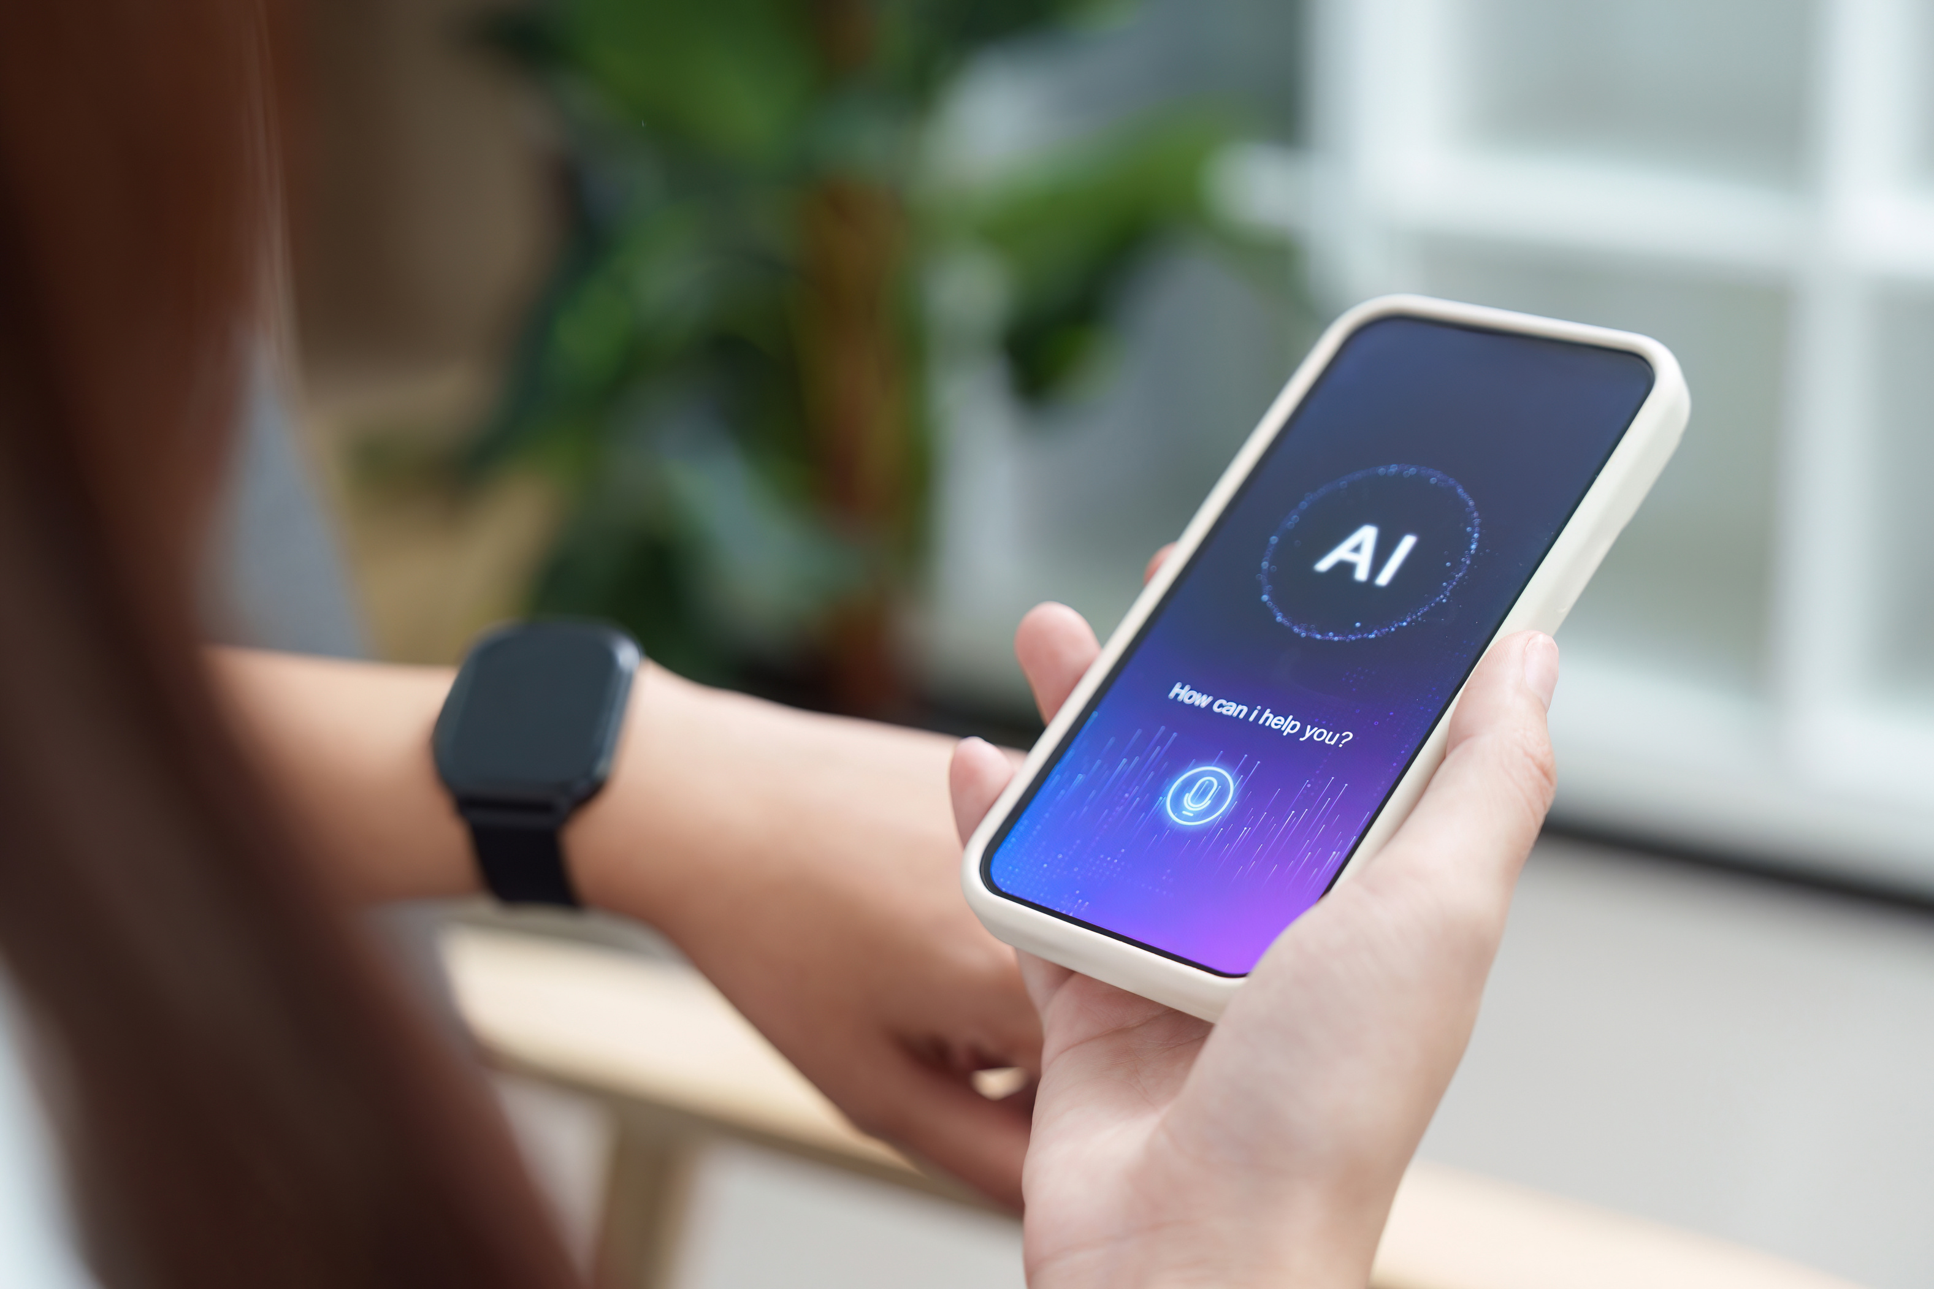
III. Update on AI at EU level

Slide 19

III. Update on AI at EU level
a. The 2025/2080(INL) on Digitalisation, artificial intelligence and algorithmic management in the workplace by MEP BUŁA
The Bula report was voted in plenary on 17/12/2025.
The final report calls on the Commission to submit a proposal on the management of algorithms in the workplace.
This initiative should include provisions regarding:
  human oversight
  right to information and consultation,
  occupational health and safety measures.
Next step
  The EU Commission should reply to the EP around June 2026.
  The Commission could choose to propose some actions in the frame of the Quality Jobs Roadmap

Slide 20

III. Update on AI at EU level
b. Digital Omnibus : consequences on GDPR
Ceemet is following the Commission proposal 2025/0360(COD) and its impact on employment.
Commission should:
  Redefine personal data so that pseudonymised data is not personal data
  Allow companies to use the GDPR’s legitimate interest basis to process personal data for AI training and system operation, under defined safeguards.
  Move cookie consent rules from the ePrivacy Directive into the GDPR and reduce unnecessary cookie.
  Introduce one‑click consent valid for six months.
  Maintain consent as the primary requirement for accessing data stored on a user’s device.
  The question of how to define “profiling” should be addressed from the perspective of AI at work.
Next step
  Awaiting for the first reading in Parliament

Slide 21

III. Update on AI at EU level
b. Digital Omnibus : consequences AI Act
The EP voted on 26 March 2026 for some changes to the text COM(2025) 836 proposed by the Commission.
Ceemet actions:
  Make sure that Digital Omnibus on AI will keep employment tools in high-risks level to avoid a specific legislation on AI at Workplace.
  Coordinate with Orgalim to advocate for the replacement of Annex A with Annex B, which allows for a distinction between safety-related functions and non-safety-related functions and lists existing directives.
  Follow with Orgalim efforts to amend the existing directives to incorporate the requirements of the AI Act regarding high-risk tools.
Next step
  Trilogue meeting is planned on 28th April 2026

Slide 22


III. Update on AI at EU level
c. IMET Project
Ceemet is associated partner to the iMET project. This four-year initiative focused on modernising social dialogue and collective bargaining in the context of artificial intelligence in the MET industries.
The aims of this project is to publish manuals with guidance to train social partners on how to build social dialogue on AI.
Next step
  Publication of the final report and the manuals

Slide 23

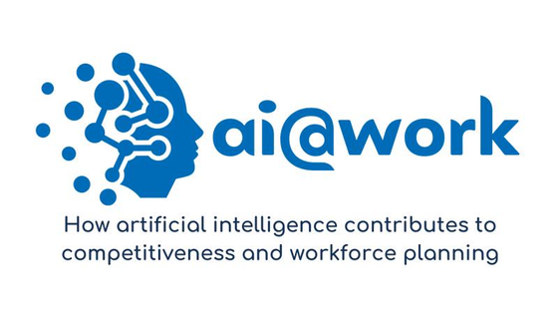
III. Update on AI at EU level
d. AI@Work Project - EEI
Ceemet coordinate the EEI ai@work project, funded by the European Union, which aims to offer an in-depth analysis of the effects of Artificial Intelligence (AI) on employers and their workforce.
First deliverables:
  Factsheet on regulatory framework
  Business cases (Airbus, Miele, Heuille & Fils)
  Factsheet on AI competitiveness: How the EU compares to the US and China
Next step
  Factsheet on skills & jobs advertisement
  Survey

Slide 24

IV. AOB

Slide 25

IV. AOB
a. Next meeting in automun

Slide 26
Thank you
for your attention

