Slide 1


51st Health & Safety Committee Meeting
14 November 2024 – Brussels

Slide 2
agenda
Agreement of 31 May 2024 minutes
Actions from 31 May 2024 meeting
National roundtable on latest developments
Workplace Mental Health
Chemicals at the workplace
Revision of EU OSH Directives: DSE & Workplace
Climate change & OSH
EFRAG
Miscellaneous

Slide 3
1. Agreement of 31 May 2024 meeting minutes
Minutes already approved by written procedure, to be approved for the record.
Notes:
I am starting with the working methods, working methods has 2 parts aims and working methods.
The aims:

Slide 4
2. Actions from 31 May 2024 meeting
Secretariat to investigate where EU-OSHA get their data
Secretariat to invite the chemicals representatives from EU-OSHA and the employer representatives from Eurofound to visit a company (only EU-OSHA) or to our upcoming meetings
Secretariat to investigate the possibility to of circulating material from ACSHH to members
Secretariat to circulate the information on the people who need to be replaced in the ACSH working parties
Secretariat to invite relevant persons from the ACSH working parties to upcoming Ceemet H&S committees
Secretariat to circulate the Italian decalogue for the prevention of heat-related diseases and exposure to solar radiation in the workplace
Secretariat to circulate the latest versions of the EFRAG documents, members could react to those drafts
Notes:
I am starting with the working methods, working methods has 2 parts aims and working methods.
The aims:

Slide 5

3. National roundtable on latest developments
Each participant will have 5 to 7 minutes to report on the latest OSH development in his country.
Notes:
I am starting with the working methods, working methods has 2 parts aims and working methods.
The aims:

Slide 6
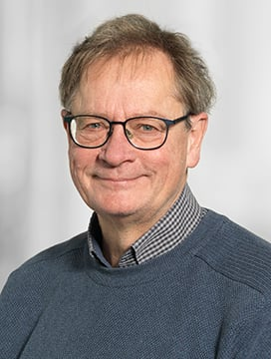
4. Mental Health at Work
Presentation on Psychological risks audit by Kåre Sørensen, Danish Industry
b. Update on the latest and forthcoming EU developments
Notes:
I am starting with the working methods, working methods has 2 parts aims and working methods.
The aims:

Slide 7

What is Tek-Sam ?
Collaboration between CO-I and Danish Industry.
CO-I is association of 9 separat Trade union with members workning in the industry
We are 9 consultants and we are always two consultants together when we are visit the company

Slide 8

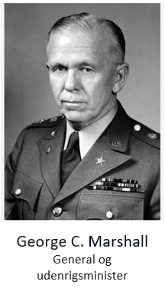
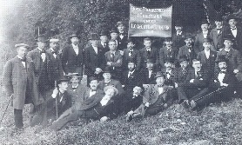
1899
After World War II, the Danish business community Marshall received help from the United States.
A prerequisite for the help was that the companies became more efficient.
In order for the employees not to suffer in the transition, the co-operative trade unions (formerly Cooperative Trade Unions) decided to take a leave of absence from the labour market. LO) and DA Cooperation Agreement.
Medbestemmelse
og drøftelser
før beslutning
Ledelse og samarbejde: Samarbejdsaftalens mål og midler gælder for ALLE virksomheder
Den første
samarbejdsaftale
Etnisk
ligebehandling
75 års Jubilæum
1947
1964
1970
1981
1986
1991
1998
2006
2022
Ny teknologi
Ligebehandling
Septemberforliget
Medindflydelse,
samarbejdsnævnet
og konsulenter
Implementering af direktiv om information, høring og håndtering af globalisering
The September Settlement in 1899
Background 40,000 workers locked out for almost 4 months
Settlement
Employers: The right to direct and distribute work
Workers: the right to organise
Notes:
Samarbejdsaftalen er en robust aftale, der kun er blevet redigeret 7 gange siden 1947.
Den seneste revision skete i 2006, da de europæiske regler om information og høring af medarbejdere på arbejdspladsen blev indført i Danmark via Samarbejdsaftalen.
Redigeringerne i Samarbejdsaftalen har fulgt udviklingen i samfundet, og er derfor stadig en tidsvarende aftale for samarbejdet på virksomheder.

Slide 9

The cooperation agreement today
Purpose of the collaboration
Employee:
Company
Well-being
Security
Competitiveness
Productivity
Motivation
Adaptability
Opportunities in the Global Economy
Competences
Notes:
Hovedorganisationerne er enige om, at en stadig forbedring af virksomhedernes konkurrencedygtighed, samt de ansattes arbejdstilfredshed er en forudsætning for virksomhedernes fortsatte udvikling, og for større trivsel og tryghed for medarbejderne.
Der er enighed om, at dette realiseres gennem et systematisk samarbejde mellem ledelse og ansatte på alle niveauer i virksomheden.

Slide 10
The cooperation agreement today
Purpose of the collaboration
Cooperation must promote common interests!

Slide 11


The "DNA" of the cooperation agreement
The common interests for the benefit of employees and the company
"Straight out of the way"
(No paragraphs)
§
§
Strive for consensus
Mutual information
Notes:
Samarbejdsaftalen bygger på at forsøge at opnå enighed. Et mål er at samarbejde om, hvordan små og store problemer kan løses til begge parters tilfredshed.
Der stemmes ikke i et samarbejdsudvalg – kan der ikke opnås enighed, må der findes løsninger et andet sted, f.eks. via lovgivning, overenskomster eller ledelsesretten.
Langt de fleste bestemmelser i Samarbejdsaften kan ved enighed tilpasses den enkelte virksomhed.

Slide 12

Objectives and means of cooperation
The common interests for the benefit of employees and the company
Motivating leadership that involves as many employees as possible
Active participation from employees and union representatives
Decentralization and delegation
Notes:
Udviklingen af det daglige samarbejde bygger på samspil mellem ledelse og ansatte. Motiverende ledelsesformer, aktiv medvirken fra medarbejdere og deres valgte tillidsrepræsentanter er nødvendige betingelser for udvikling af samarbejdet i virksomheden.
Anvend ledelses-, samarbejds- og informationsformer, der tilskynder til, at flest mulige medarbejdere inddrages i tilrettelæggelsen og organiseringen af det daglige arbejde. Derved sikres de ansattes medvirken til ved deres viden, indsigt og erfaring at bidrage til en udvikling af virksomheden, og til at den daglige drift af de enkelte afdelinger i virksomheden kan foregå på en hensigtsmæssig og effektiv måde.

Slide 13
Cooperation-
Committee
S
U
SU
Daily
cooperation
The daily collaboration
Management
& Shop Steward
Notes:
I samarbejdsudvalget lægges rammerne for samarbejdet mellem ledelse og ansatte på alle niveauer i virksomheden. Konkrete problemer i det daglige samarbejde skal ofte løses lokalt. Pas på med, at samarbejdsudvalget ikke bliver stedet for løsning af alle praktiske problemer på virksomheden.
Vær opmærksom på, at samarbejdet mellem ledelse og TR, foregår som det er beskrevet i overenskomsterne.

Slide 14
The overall objectives of the cooperation committee:
De fælles interesser til gavn for medarbejdere og virksomheden
Develop and engage as many people as possible in the daily collaboration
Prevention of illness and absence in the company
S
U
Ensure good working conditions, security and well-being
Increase employees' knowledge of the company's operations, finances, etc.

Slide 15

SU develops principles for the companys:
Company’s policies
Seniorpolicy in the company
Educationpolicy and retraining
S
U
Storage and use of personal data
Equal treatment and integration
Notes:
Læs mere om samarbejdsudvalgets udvikling i Samarbejdsaftalen på side 9.
Det kan være en god ide, at arbejdet med udformningen af konkrete politikker sker i en mindre arbejdsgruppe og/eller i HR efter drøftelse i samarbejdsudvalget. F.eks. At udforme en politik omkring kritisk sygdom, arbejdsulykker eller håndtering af kriser.

Slide 16
SU and information flow
Finance & orders
Future
Market
Production
Employment
Major changes
Employees must inform SU about the conditions that are important for the climate of cooperation
S
U
The information must be provided at such an early stage that the views, ideas and suggestions of the employees can be included in the decision-making basis
Management
Employees
Confidentiality can be imposed
Notes:
Målet med den gensidige information er, at medarbejdere og ledelse hjælper hinanden med, at virksomheden klarer sig bedst muligt.
I et velfungerende samarbejdsudvalg er det vigtigt at lytte til hinanden og være åben, samt at man aktivt deltager.

Slide 17
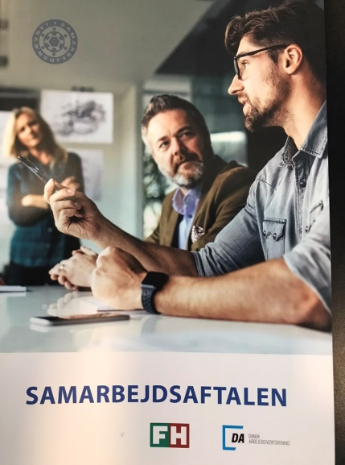
Establishment of SU?
≥ 35 employees: SU if one party wants it
The cooperation agreement also applies without SU
Deviations can be agreed upon by agreement and if the possibilities of the agreement are not lost
Notes:
Læs mere om etablering af samarbejdsudvalg i Samarbejdsaftalen side 15 – 19.
I kan få hjælp af TekSam til oprettelse af samarbejdsudvalg – også til at komme godt i gang.
I koncerner med adskilte datterselskaber, som har et salgs- eller produktionsmæssigt samarbejde, anbefales det at oprette koncernudvalg, som sammensættes af repræsentanter fra datterselskabernes samarbejdsudvalg. I koncernudvalg drøftes spørgsmål af fælles interesse for datterselskaberne.

Slide 18
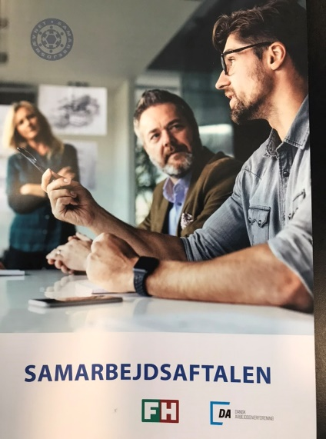


Composition of SU?
Equal number on the A and B sides
Strive for representative composition
Union representatives from FH unions are born members (And everyone who is a member of an FH union is eligible for election)
Special professional groups can be supplemented
The management chooses its own representatives – members of the "Leaders" are guaranteed a seat
Notes:
Læs mere om sammensætningen af samarbejdsudvalg i Samarbejdsaftalen side 15 – 17.
Såfremt der, inden valget til samarbejdsudvalget, stilles krav herom, kan b-siden i samarbejdsudvalget suppleres med repræsentanter for grupper, der ikke er repræsenteret gennem de ordinære samarbejdsudvalgsmedlemmer eller tillidsrepræsentanter.
Med grupper forstås særlige faggrupper eller grupper med særlig uddannelse.

Slide 19
Number of employees determines size
S
U
Employees
Group A
Group B
35-50
2
2
51-100
3
3
101-200
4
4
201-500
5
5
Over 500
6
6
Notes:
Gruppe a repræsenterer den ansvarlige virksomhedsledelse og de tekniske
og merkantile funktionærer, der ikke kan være medlem af en arbejderorganisation
i henhold til Hovedaftalens bestemmelse herom.
Gruppe b repræsenterer de øvrige ansatte i virksomheden.

Slide 20
6 meetings annually
S
U
Management appoints chairman
Employees Vice Chairman
Chairman and Vice-Chairman set the agenda
8 days before/after
A secretary is appointed jointly
The Chairman and Vice-Chairman approve the minutes
Notes:
Læs mere herom i Samarbejdsaftalen side 12 - 13

Slide 21
SU exchanges views on:
Major restructuring in the company
Organization of production
Organisation of work
S
U
Notes:
Læs mere herom i Samarbejdsaftalen på side 10.

Slide 22

SU assesses the consequences of:
New technology and major changes
Retrain employees
In the event of a loss of jobs, the company must seek to...
S
U
Reassign to other work
In addition, SU must be informed about the principles
for productivity-enhancing wage systems
Notes:
Det er vigtigt, at SU har en dialog i forbindelse med større omlægninger og indførsel af ny teknologi, og tager hensyn til de berørte medarbejdere.

Slide 23


TekSam offers companies and employees:
Start of liaison committee and inspiration for the work in SU
Work with well-being and psychological working environment
Theme days and an anniversary
Work on education and skills development
Help with collaboration problems
Collaboration on green transition
Notes:
Vores aktiviteter er mangeartede:
Konsulenttjenesten, temadage, udgivelse af pjecer, nyhedsbreve og hjemmeside, projekter og meget mere.

Slide 24
Project mental wellbeing
CEEMET
14/11/2024
51st Health & Safety Committee
Geert De Prez

Slide 25

Waarom ?
“We zetten in op een verbetering van de fysieke en mentale gezondheid van onze medewerkers.”
We are committed to improving the physical and mental health of our employees."

Slide 26
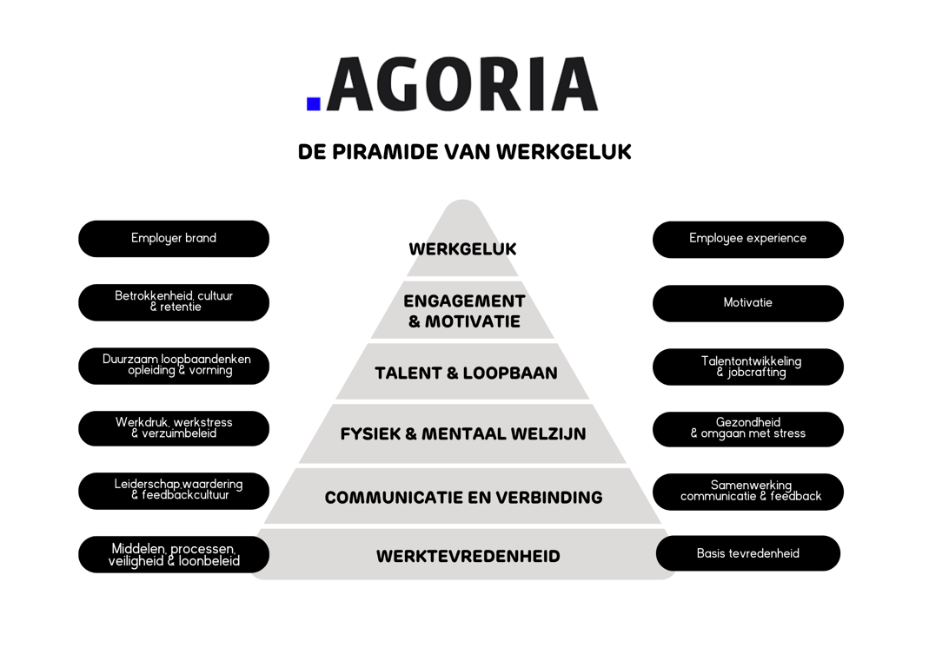
Pyramid of Work Happiness

Slide 27





Mentaal Welzijn Scan

Slide 28
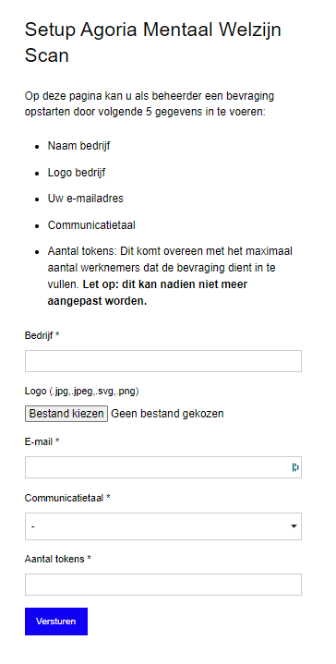
Set up survey

Slide 29
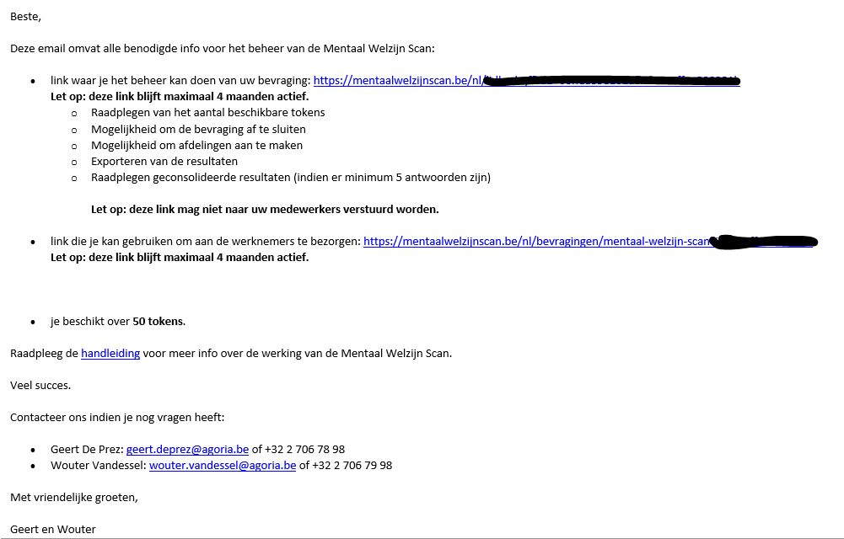
E-mail with information

Slide 30
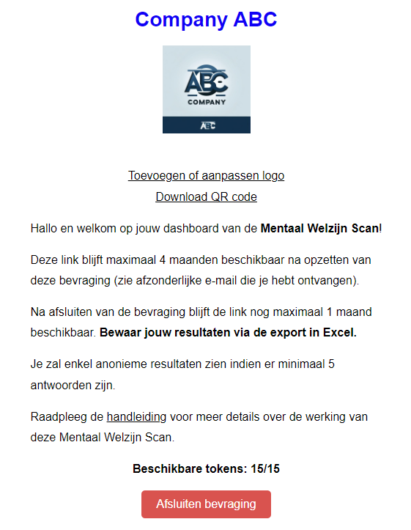
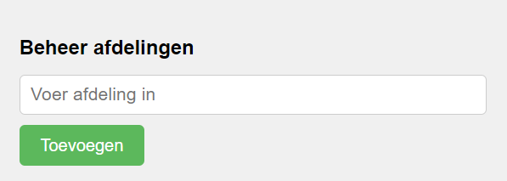
Survey management

Slide 31
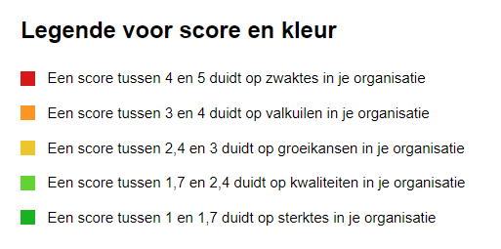
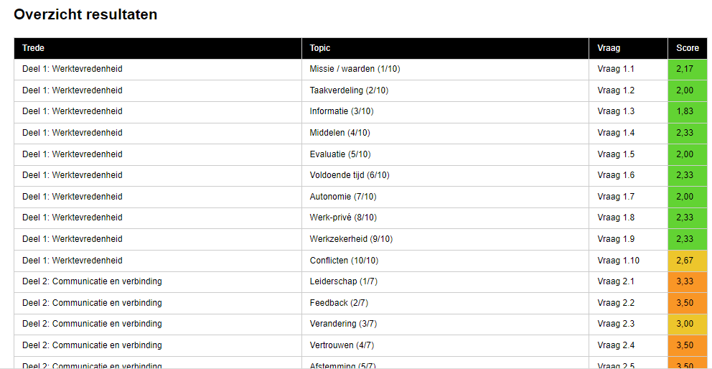
Results (1)

Slide 32
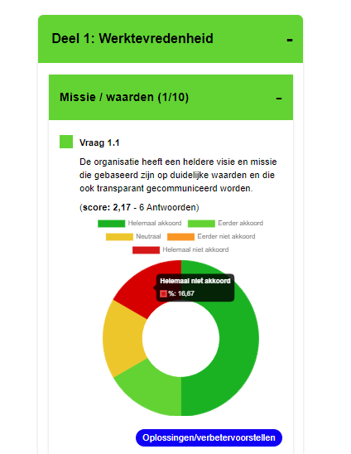
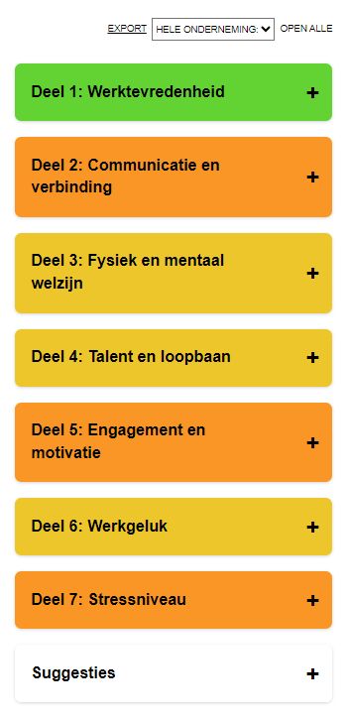
Results (2)

Slide 33
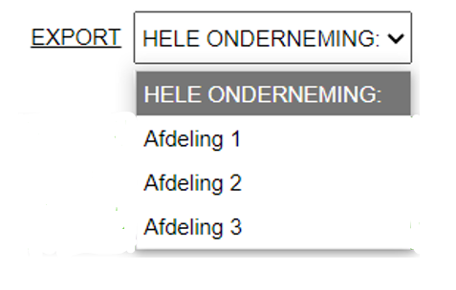
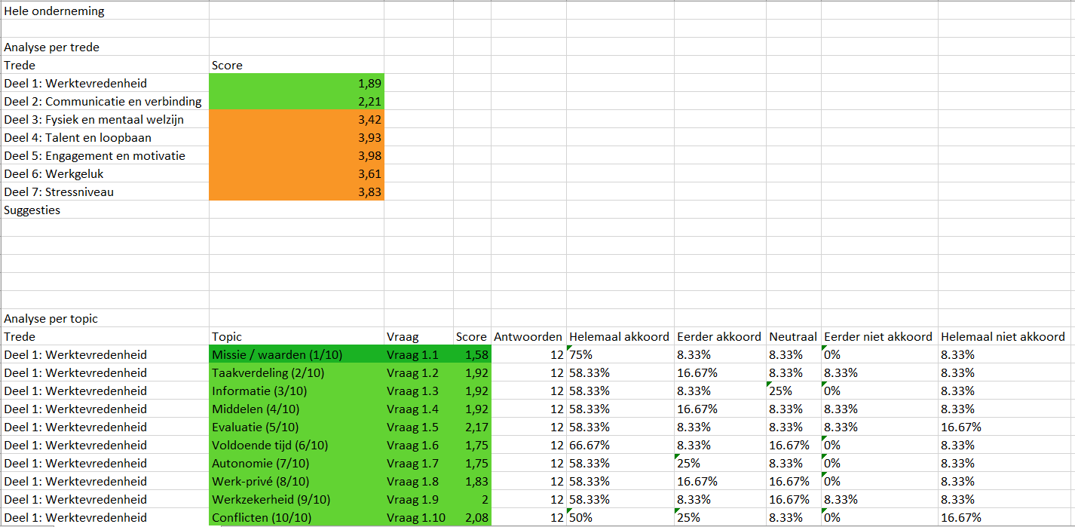
Export (1)

Slide 34
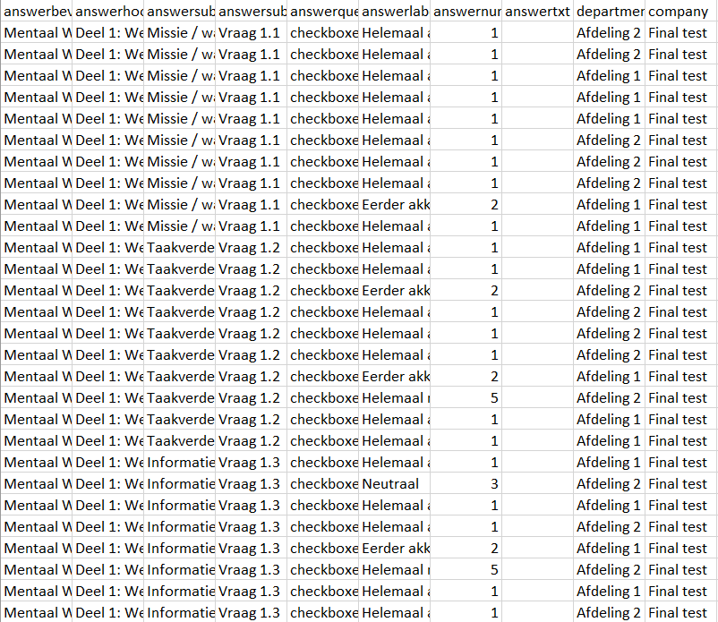
Export (2)

Slide 35

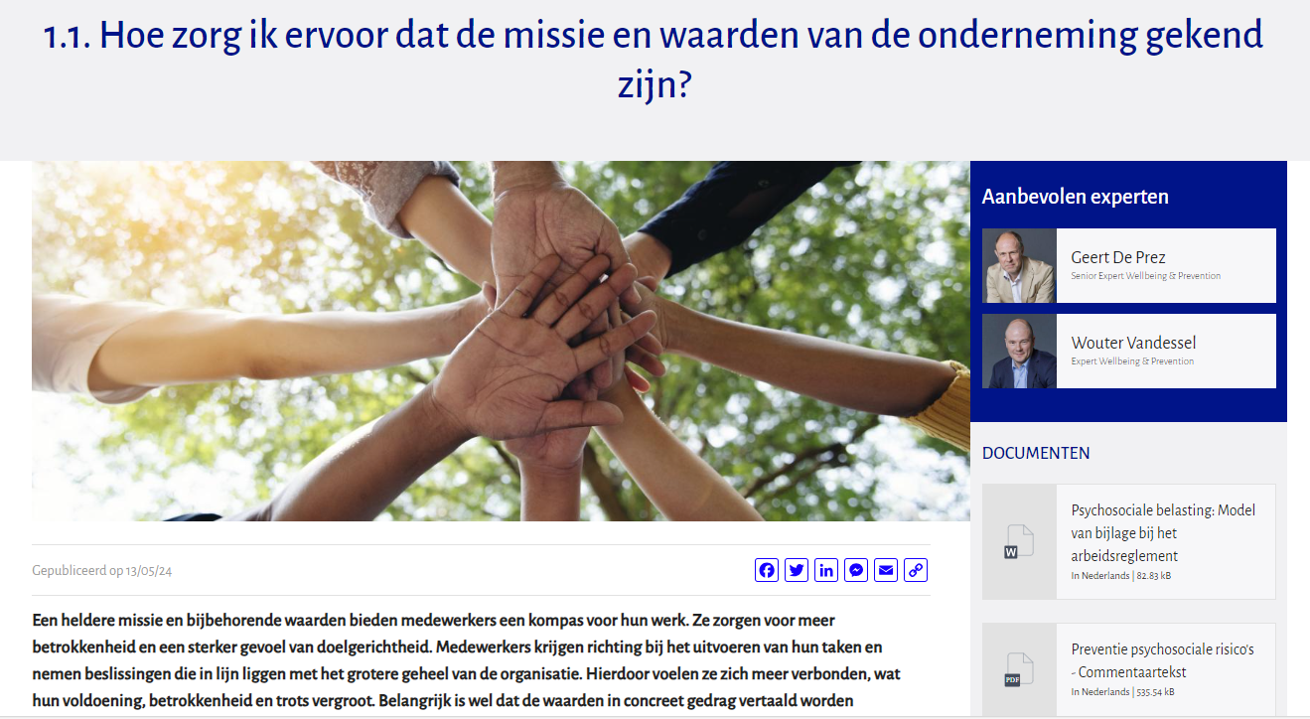
Solutions (1)

Slide 36
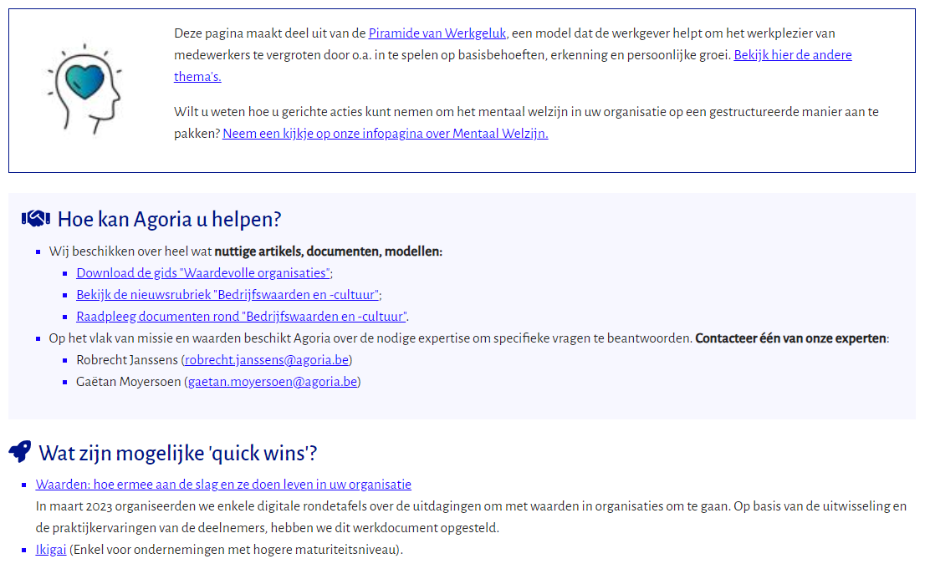
Solutions (2)

Slide 37
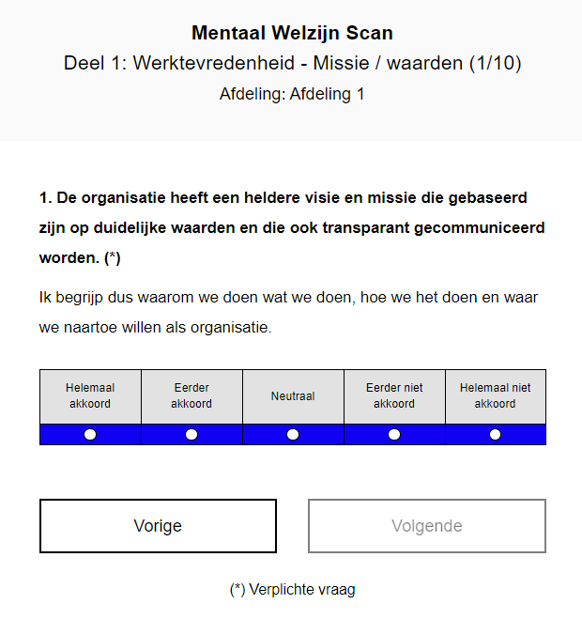
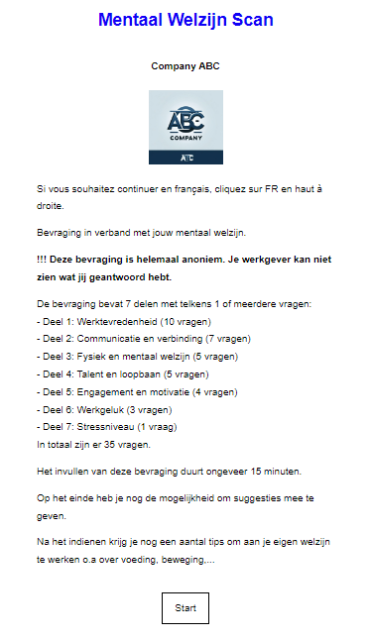
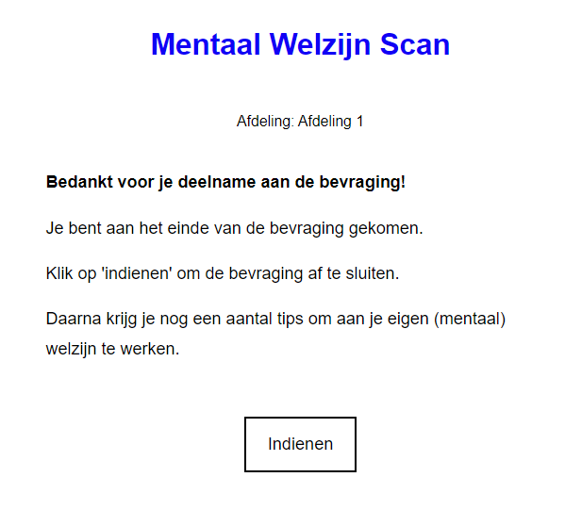
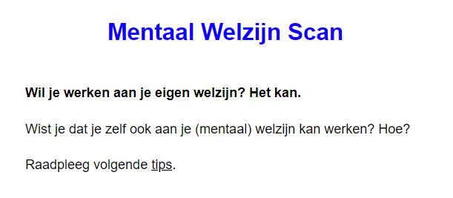
Employee

Slide 38

Vervolg?
Mentaal welzijn | Agoria
2025 + ….

Slide 39
5. Chemicals at the Workplace
Update on latest developments
a. Carcinogens, Mutagens or Reprotoxic substances at Work Directive
Welding fumes, Cobalt, PAHs, 1,4 dioxane & Isoprene.
b. NEPSI
Notes:
I am starting with the working methods, working methods has 2 parts aims and working methods.
The aims:

Slide 40
6. Revision of EU OSH Directives
Update by the Secretariat & members of the ACSHH
Display Screen Equipment Directive 90/270/EEC
Workplace Directive 89/654/EEC
Notes:
I am starting with the working methods, working methods has 2 parts aims and working methods.
The aims:

Slide 41
7. Climate change & OSH
Update on EU & international developments
Notes:
I am starting with the working methods, working methods has 2 parts aims and working methods.
The aims:

Slide 42

8. EFRAG
Update by Franck Gambelli
OSH issues linked to the work of the European Financial Reporting Advisory Group (EFRAG).
Notes:
I am starting with the working methods, working methods has 2 parts aims and working methods.
The aims:

Slide 43
9. Miscellaneous
Date & place of the 52nd Health & Safety Committee
AOB
Notes:
I am starting with the working methods, working methods has 2 parts aims and working methods.
The aims:

Slide 44

CONTACT
ceemet
Spaces
Rue Belliard 40
1040 Brussels, Belgium
Tel: +32 2 786 30 45
secretariat@ceemet.org
www.ceemet.org
@CEEMET
/CEEMET.org

