Slide 1
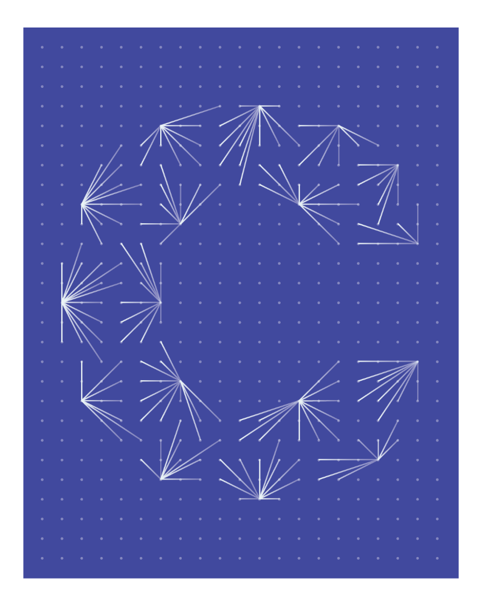

Ceemet Ad-Hoc Group on artificial intelligence
Hybrid meeting
17 February 2025 – Brussels
www.ceemet.org

Slide 2

AGENDA
Item 1 – What are the last update on AI at EU level?
Item 2 – What has your organisation been doing on AI?
Item 3 – How does Ceemet position itself on AI?
Item 4 - A.O.B.
ceemet
European Tech &
Industry Employers

Slide 3


Item 1. What are the last update on AI at EU level?
AI Act
New EU Commission
EESC
Trade Unions reactions
The need of Employers’reaction
ceemet
European Tech &
Industry Employers
Notes:
The implementation of AI Act started at the beginning of the month on 2 February 2025. Since, the AI Office and the Commission are publishing the AI Guidance to detail the prohibited AI practices. At this stage AI Act reinforce the transparency and the copy-rights rules for the companies.
As you know, we have a new commission. Delphine already met Commissioner Minzatu. From what we know, she will not prepare this year a legislation on AI at work. She is worried about the question of HR such as the monitoring of employees under the influence of the trade unions.
EESC the group of employees is really active and published reports and did several conference – trade unions oriented- they call for a proposal.
Trade unions are more and more active in this file and call for a new legislation on AI at work.

Slide 4
Item 2. What has your organisation been doing on AI?
a. Roundtable on national development
Members can present their studies or surveys. What is the discussion at the national level around AI at work? Does one of the member countries already have legislation relating to AI at work?
b. What does your organisation expect from this working group?
ceemet
European Tech &
Industry Employers

Slide 5

Item 3. How does Ceemet position itself on AI?
a. Preparation of a Ceemet position paper on AI at workplace: proposal for a structure
b. Preliminary results AI Survey
c. Ceemet in OSH campaign
This Photo by Unknown Author is licensed under CC BY
ceemet
European Tech &
Industry Employers

Slide 6
Item 3. How does Ceemet position itself on AI?
a. Preparation of a Ceemet position paper on AI at workplace: proposal for a structure
Introduction
AI changes our societies (like the Internet or car apparition)
Remind the legislative disposal that we have at the EU level (GDPR/ AI Act)
Recognition of risk and opportunities
Confirm the human-centric approach
Competitiveness of EU companies in global markets / avoid being isolated
Definition of AI
Notion of machine learning
Exclusion of software or robots
Opportunities and risks (finding the right balance)
2. HR issues
-CV in the selection process (no discrimination. Ethical / match for skills) ex: FME/ MESS
-Monitoring issues/Decision-making and AI on Management tasks
ceemet
European Tech &
Industry Employers

Slide 7
Item 3. How does Ceemet position itself on AI?
a. Preparation of a Ceemet position paper on AI at workplace: proposal for a structure
3. H&S
- Already have legislation
- The need for a methodology of risk assessment Ex: mental health issues
4. Skills
Skills needed to develop AI
Facilitate the matching of jobs and skills ex: TIF
Knowledge of the legislation particularly for the SMEs and their implementation (GDPR? AI Act?)
Attractiveness of the Industries
ceemet
European Tech &
Industry Employers

Slide 8
Item 3. How does Ceemet position itself on AI?
a. Preparation of a Ceemet position paper on AI at workplace: proposal for a structure
5. Need for investment
For SMEs
For upskilling and reskilling
For innovation
6. Role of social partners
Implement legislations
Facilitate the introduction of AI at work
Collective bargaining ex: UIMM/ Ethical committees ex: MESS
7. Example of MET industries (concrete examples of using AI)
ceemet
European Tech &
Industry Employers

Slide 9
Item 3. How does Ceemet position itself on AI?
b. Preliminary results of Ceemet’s survey – 10/02/2025
COUNTRY | Count
Italy | 27
Turkey | 21
Spain | 16
Germany | 10
Austria | 2
Total | 76
For some questions, we will add 209 Helvetic companies and 265 Danish Companies
Switzerland can be added
ceemet
Switzerland can be added
Notes:
How can we integrate the answer from UK? What about Finland and France?
If Denmark, Swiss or Finland have the details of the results of their studies it will be easier to integrate their data. I didn’t do it yet because it will false a bit the result. I hope to obtain around 200 replies by countries to have the most relevant results.

Slide 10
Item 3. How does Ceemet position itself on AI?
b. Preliminary results of Ceemet’s survey
ceemet
European Tech &
Industry Employers

Slide 11
Item 3. How does Ceemet position itself on AI?
b. Preliminary results of Ceemet’s survey
ceemet
European Tech &
Industry Employers

Slide 12
Item 3. How does Ceemet position itself on AI?
b. Preliminary results of Ceemet’s survey
Switzerland & Denmark can be added
ceemet
European Tech &
Industry Employers

Slide 13
Item 3. How does Ceemet position itself on AI?
b. Preliminary results of Ceemet’s survey
ceemet
European Tech &
Industry Employers
Switzerland & Denmark can be added

Slide 14
Item 3. How does Ceemet position itself on AI?
b. Preliminary results of Ceemet’s survey
Denmark can be added
ceemet
European Tech &
Industry Employers
Switzerland & Denmark can be added

Slide 15
Item 3. How does Ceemet position itself on AI?
b. Preliminary results of Ceemet’s survey
Switzerland & Denmark can be added
ceemet
European Tech &
Industry Employers

Slide 16
Item 3. How does Ceemet position itself on AI?
b. Preliminary results of Ceemet’s survey
Q12 Any other comments
Austria (NACE 32) 200-500: AI is not allowed at our company. All tools are restricted from access.
Turkey (NACE 25) 50-250 : The evaluation is complete, it is important to establish a commission on artificial intelligence
Turkey (NACE 29) 1000: We are making pioneering developments, but the fact that AI services do not yet have the ability to produce output at the desired level hinders or slows down these studies.
ceemet
European Tech &
Industry Employers

Slide 17
Item 3. How does Ceemet position itself on AI?
b. Participation of the OSH Campaign on AI
Topic ''Workers management through AI‘’
From February and May 2025
ceemet
European Tech &
Industry Employers
Notes:
If you can provide good practices or want to share something with us for Ceemet social media, it will be with pleasure that Viktorya will design and publish it.

Slide 18
Item 4. A.O.B
a. Next meeting
ceemet
European Tech &
Industry Employers
Notes:
Do you have any companies that sign the AI Pact? https://digital-strategy.ec.europa.eu/en/policies/ai-pact
Question from Sweden about the administrative burdens and GDPR

Slide 19

Thank you for your attention
Ceemet
European Tech &
Industry Employers
200 000 Companies
17M Direct & 35M incl. Indirect jobs
EU Social Partner

